Slide 1
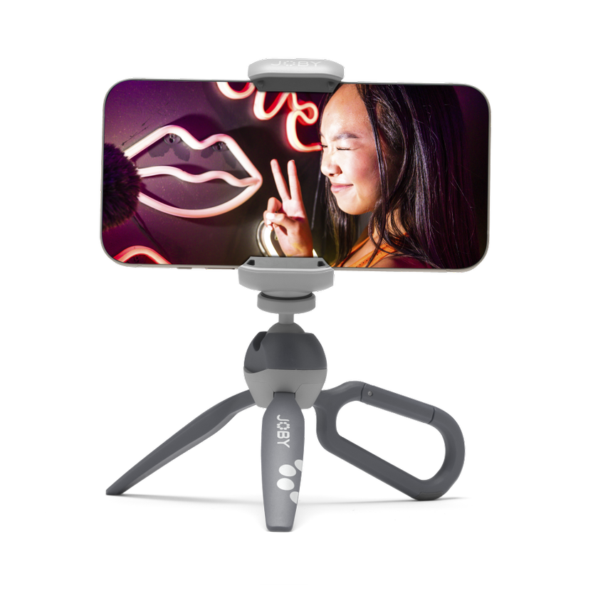
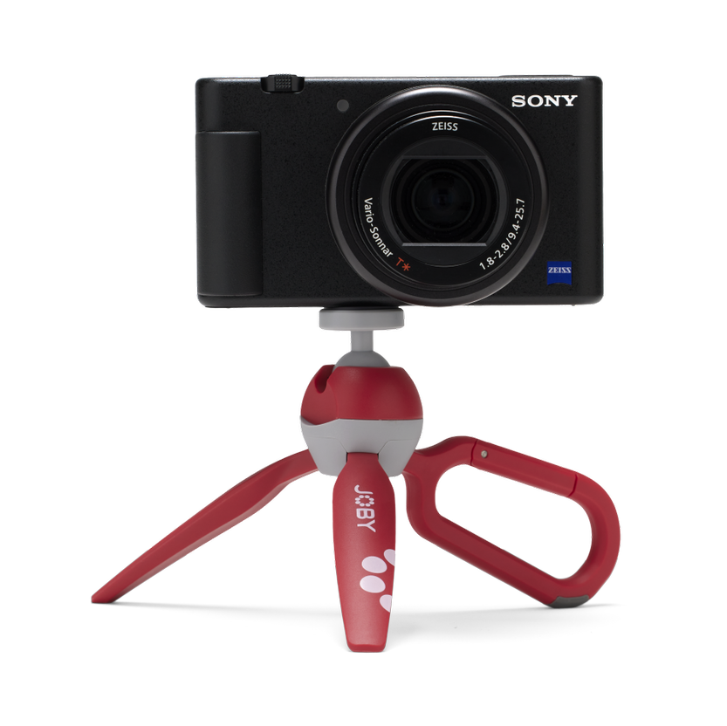
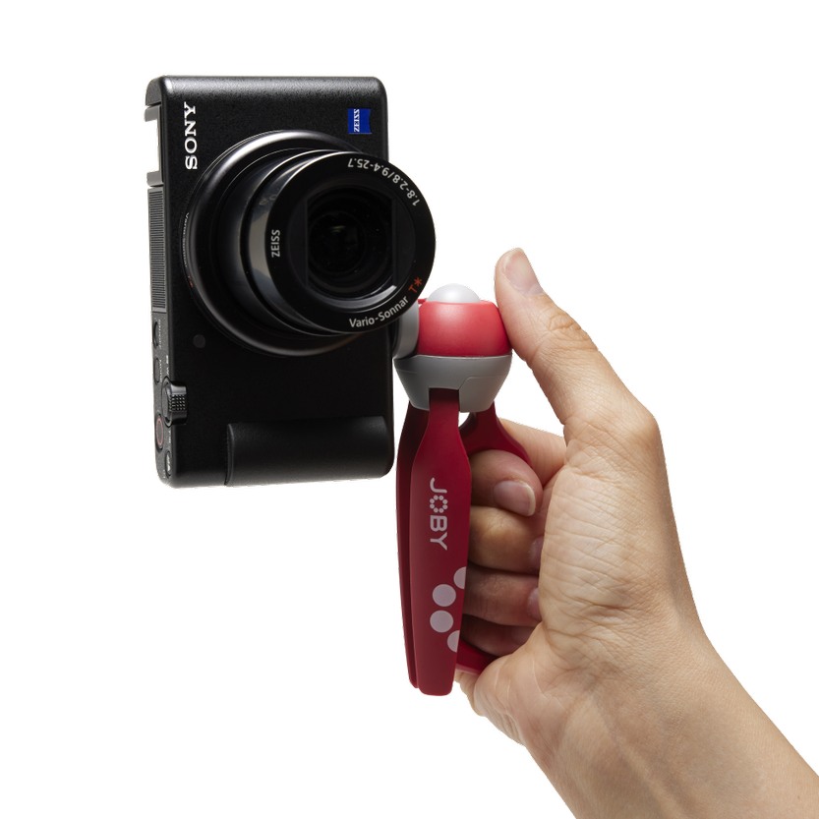
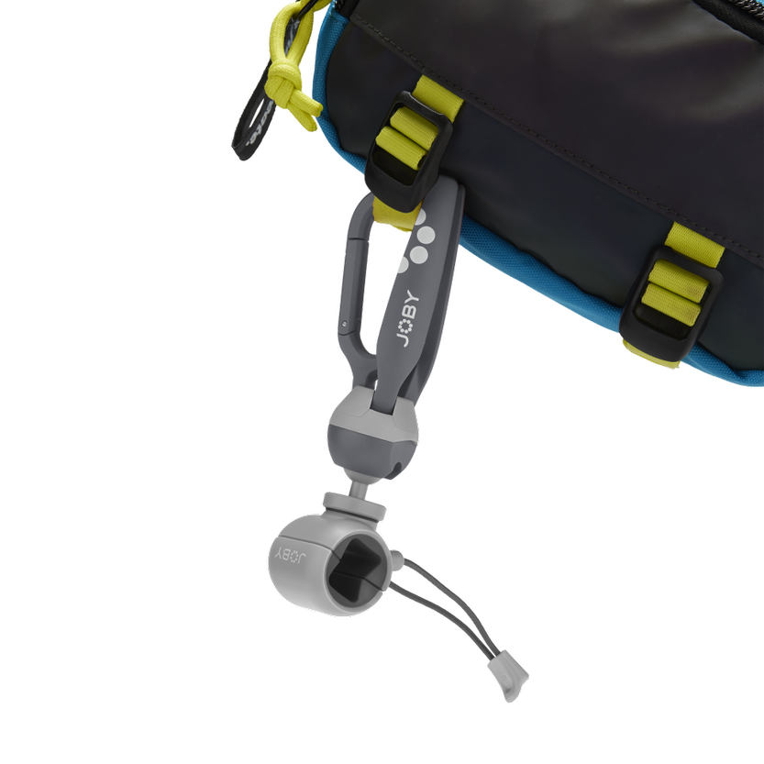
HandyPod Clip
The Mini Phone Tripod with Carabiner
JB01839-BWW (Grey) / JB01840-BWW (Red)
MULTI-DEVICE
Compact size, supports both compact cameras and smartphones
Sell Sheet
Introducing HandyPod Clip, the super cool mini Vlogging tripod with a built-in carabiner for ultimate convenience!
Based on the wildly popular HandyPod 2, HandyPod Clip is a pocket-sized, rigid-legged tripod with a built-in ball head that transforms into a handy grip. One leg goes rogue and becomes a trusty carabiner, allowing you to hang it anywhere—backpack strap, belt loop, or even your unicorn's horn!
No more shaky vlogs or wobbly selfies. With HandyPod Clip, use the carabiner as your vlogging sidekick for a sturdy grip on your device. The built-in self-locking ball head lets you seamlessly switch from horizontal to vertical shooting, adding another level of awesomeness to your content.
Compatible with smartphones, compact cameras, video lights, and microphones, HandyPod Clip is your go-to companion for epic vlogs and unforgettable memories. Clip it on, feel the power, and let the creative journey begin—rock the vlogging world!
Fits: phone width: 64-98mm; depth: Max.11mm
Payload (camera mode): 1.1 lb / 500g
Dims: 6.2 x 1.8 x 1.5 in / 16 x 5 x 4 cm
Connection: ¼-20” with included phone mount
Materials: Glass-filled Nylon, Aluminum, Steel, TPE, Brass
Color Options: Grey / Red
Manufacture Warranty: One Year Warranty
FLEXIBLE
Easy angle adjustments
with self-locking
ball head
VERSATILE
Sturdy tripod legs fold into a vlogging hand grip
CLIP IT!
Convenient carrying using the built-in carabiner

