Slide 1
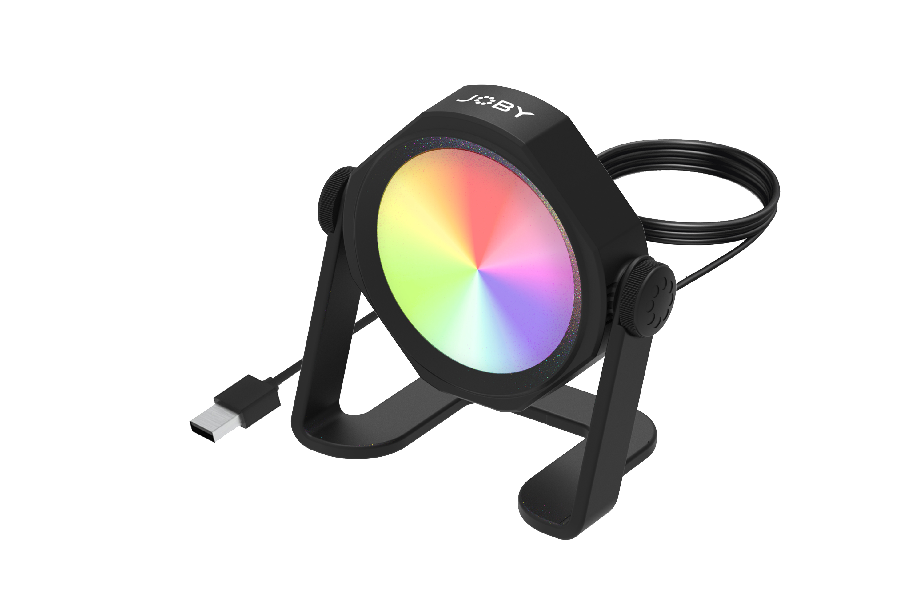
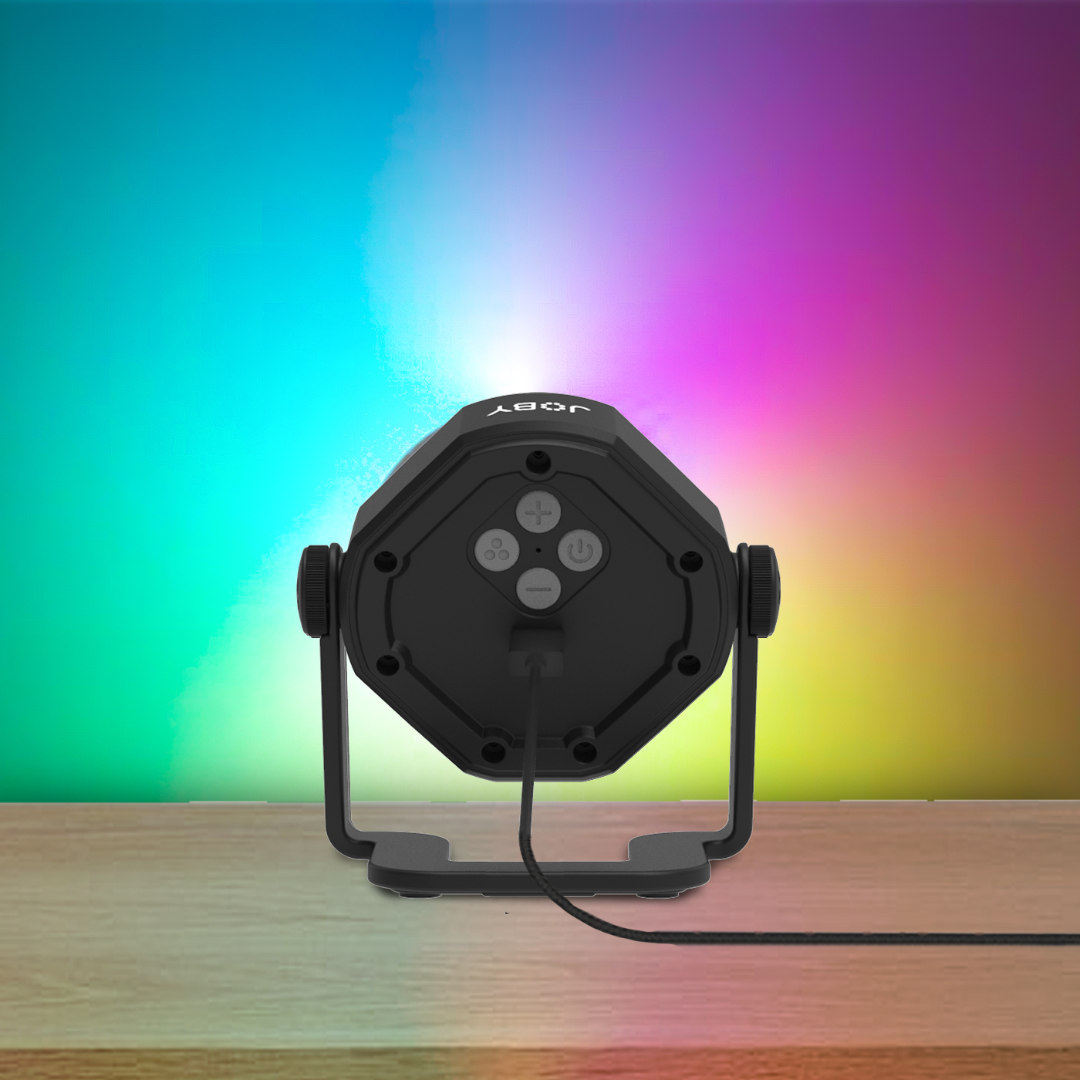
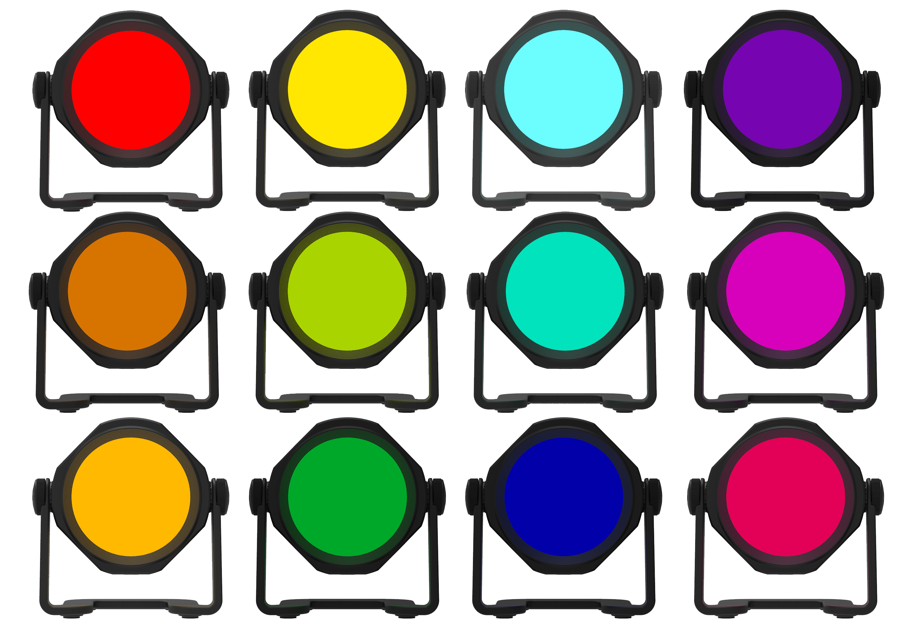
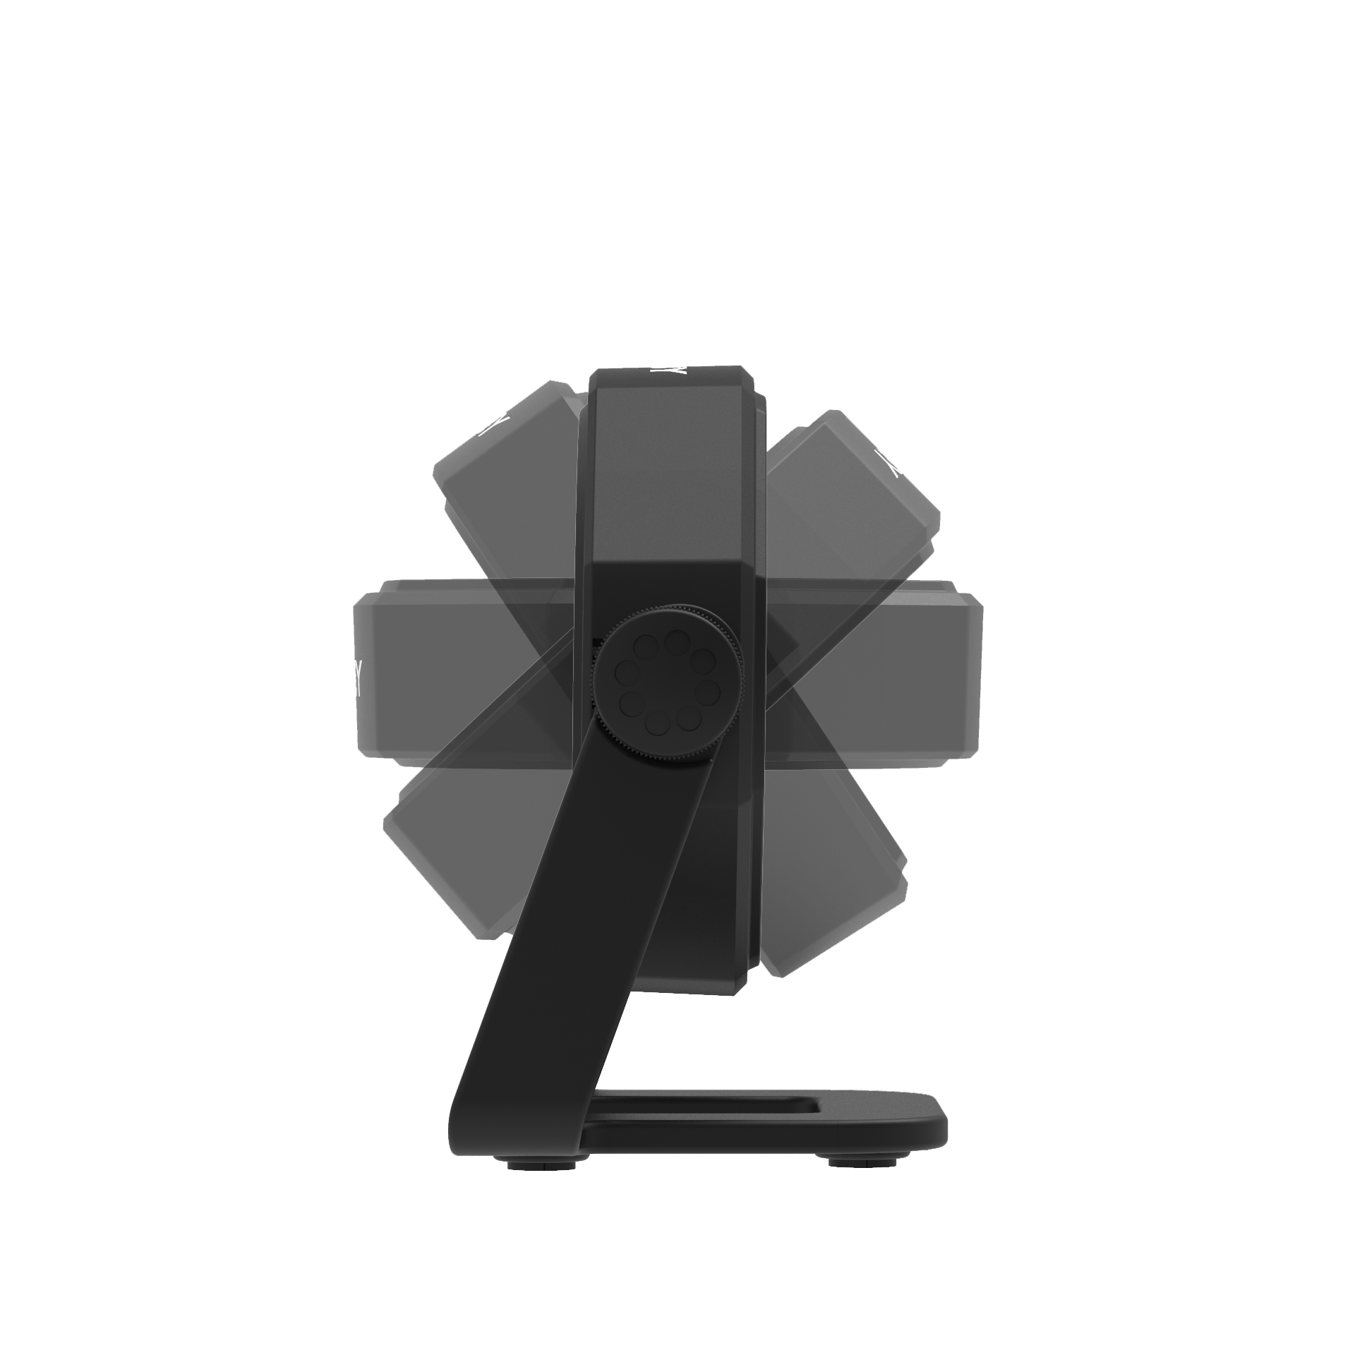
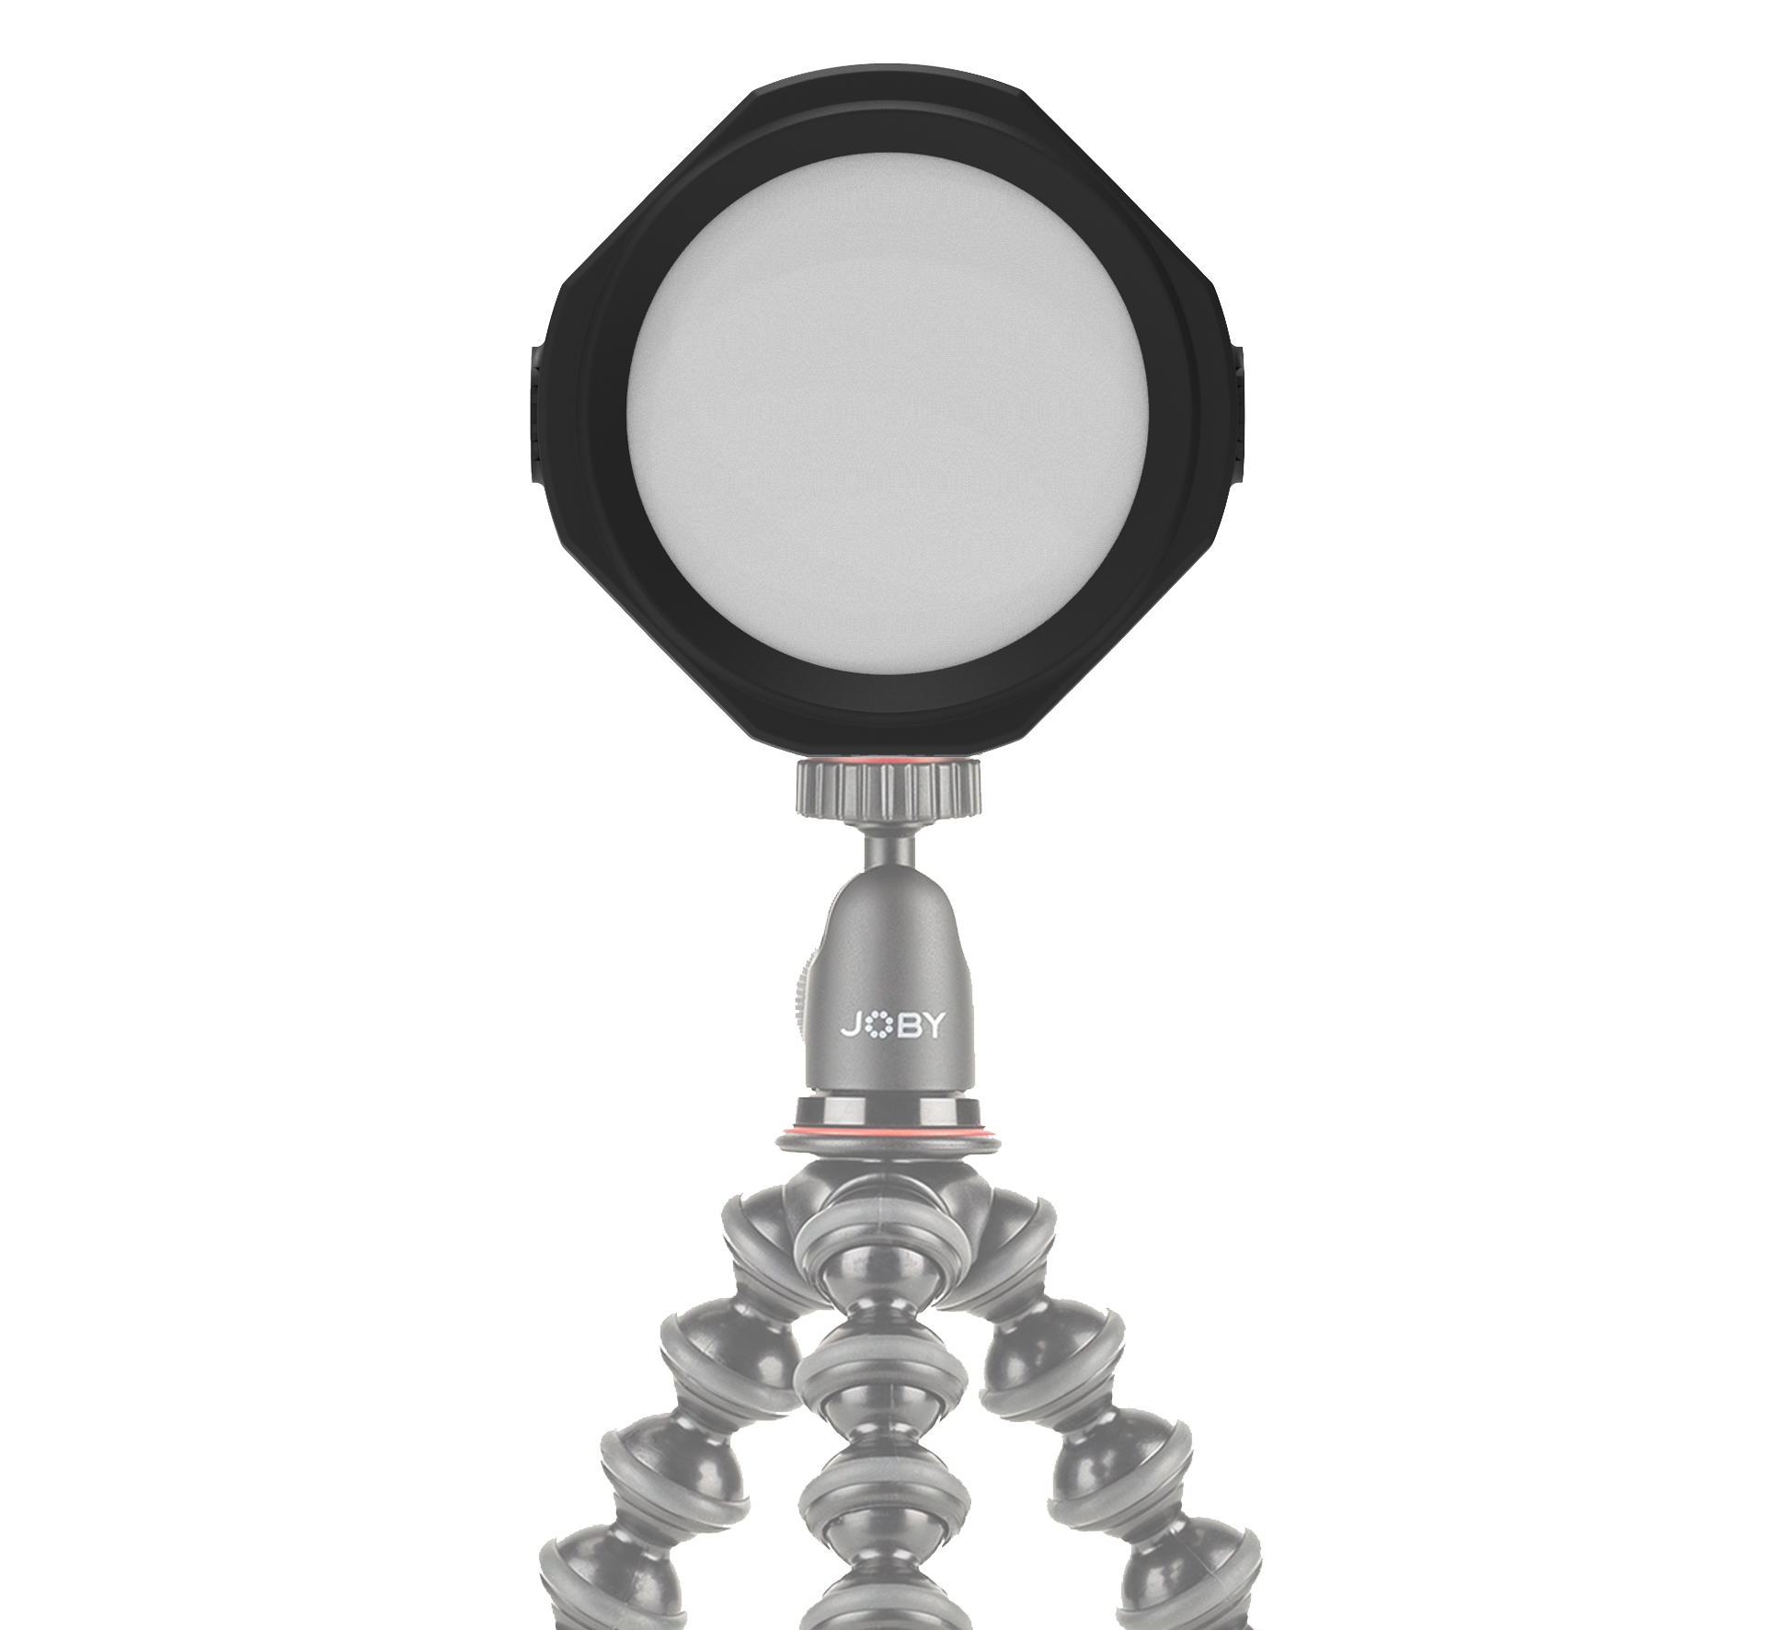
JOBY Beamo™ Studio Background Light
12-color background LED light for your YouTube home studio
JB01866-BWW
Sell Sheet
Add color
to the background walls or objects for special effects
Multi-color LED background light that makes your YouTube videos pop.
The Beamo™ Studio Background Light is a one-of-a-kind LED light that helps to color your video background without using background paper or paint.
With 10 brightness levels and 12 colors adjustability, this small LED light projects wide angle light beam to any walls or objects and make them colorful. Powered by USB, this low-heat light allows you to record videos or live-stream for a prolonged period without worrying battery live. The USB-C to USB-A cable is also detachable if you wish to use a longer one of your own.
The built-in tilting stand allows you to angle it to the most challenging angles. You can even screw it (screw not included) on the wall by using the cut out of the base. It also connects to the GorillaPod® or any tripod, when need be, to provide flexible placement.
Get one and up your content game today!
Materials: ABS
Lux @ 0.5m: 90 (Red color) ±10%
What’s in the box: Background light & USB power cable
10 brightness levels and 12 colors for creative lighting effect
Built-in tilting light stand for creative lighting
Connects to GorillaPod® or any tripods for flexible placement

