Slide 1
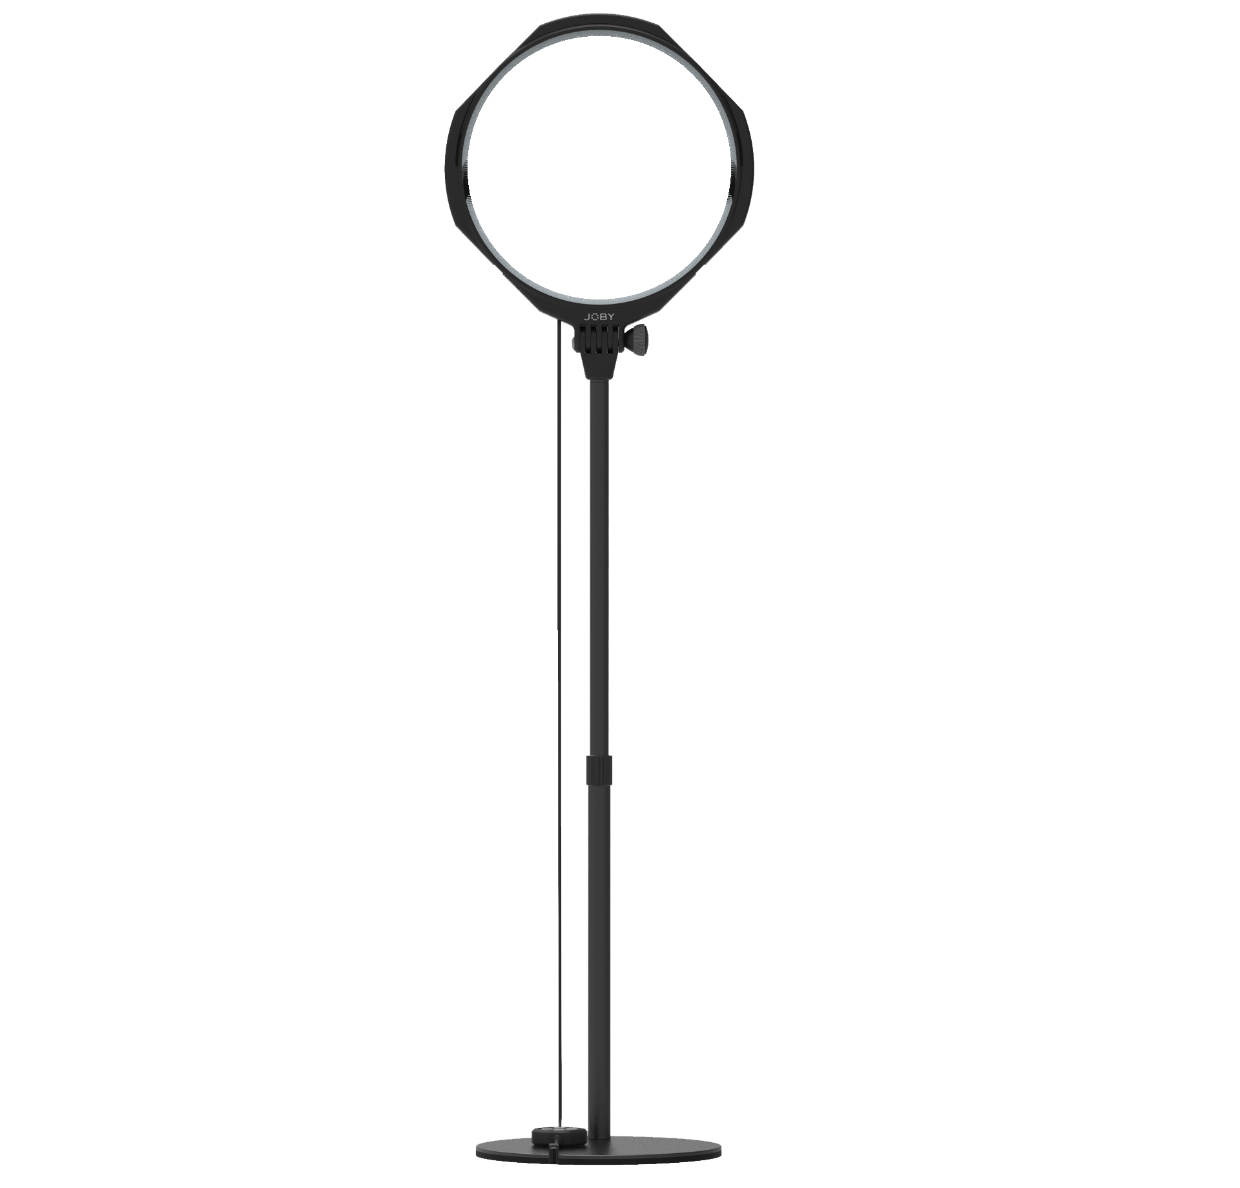
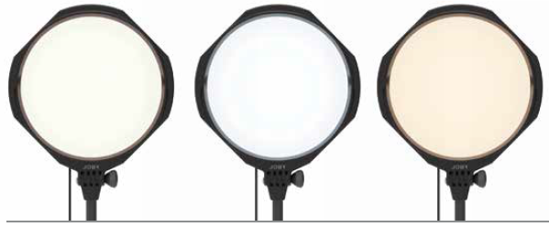
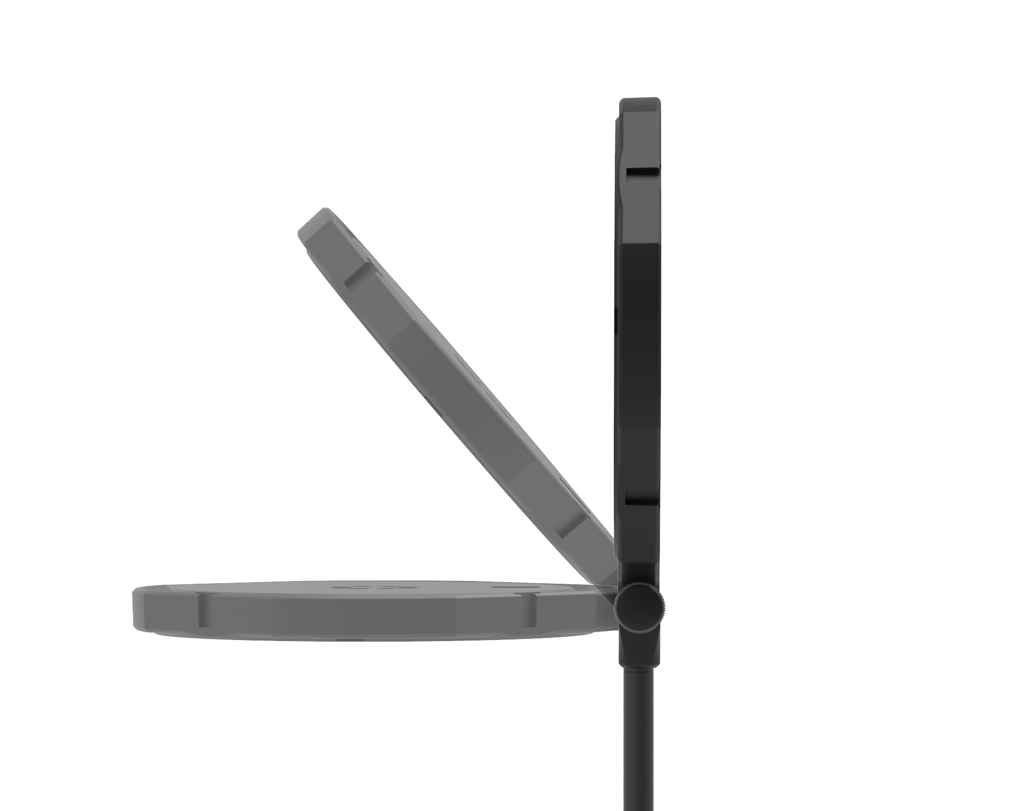
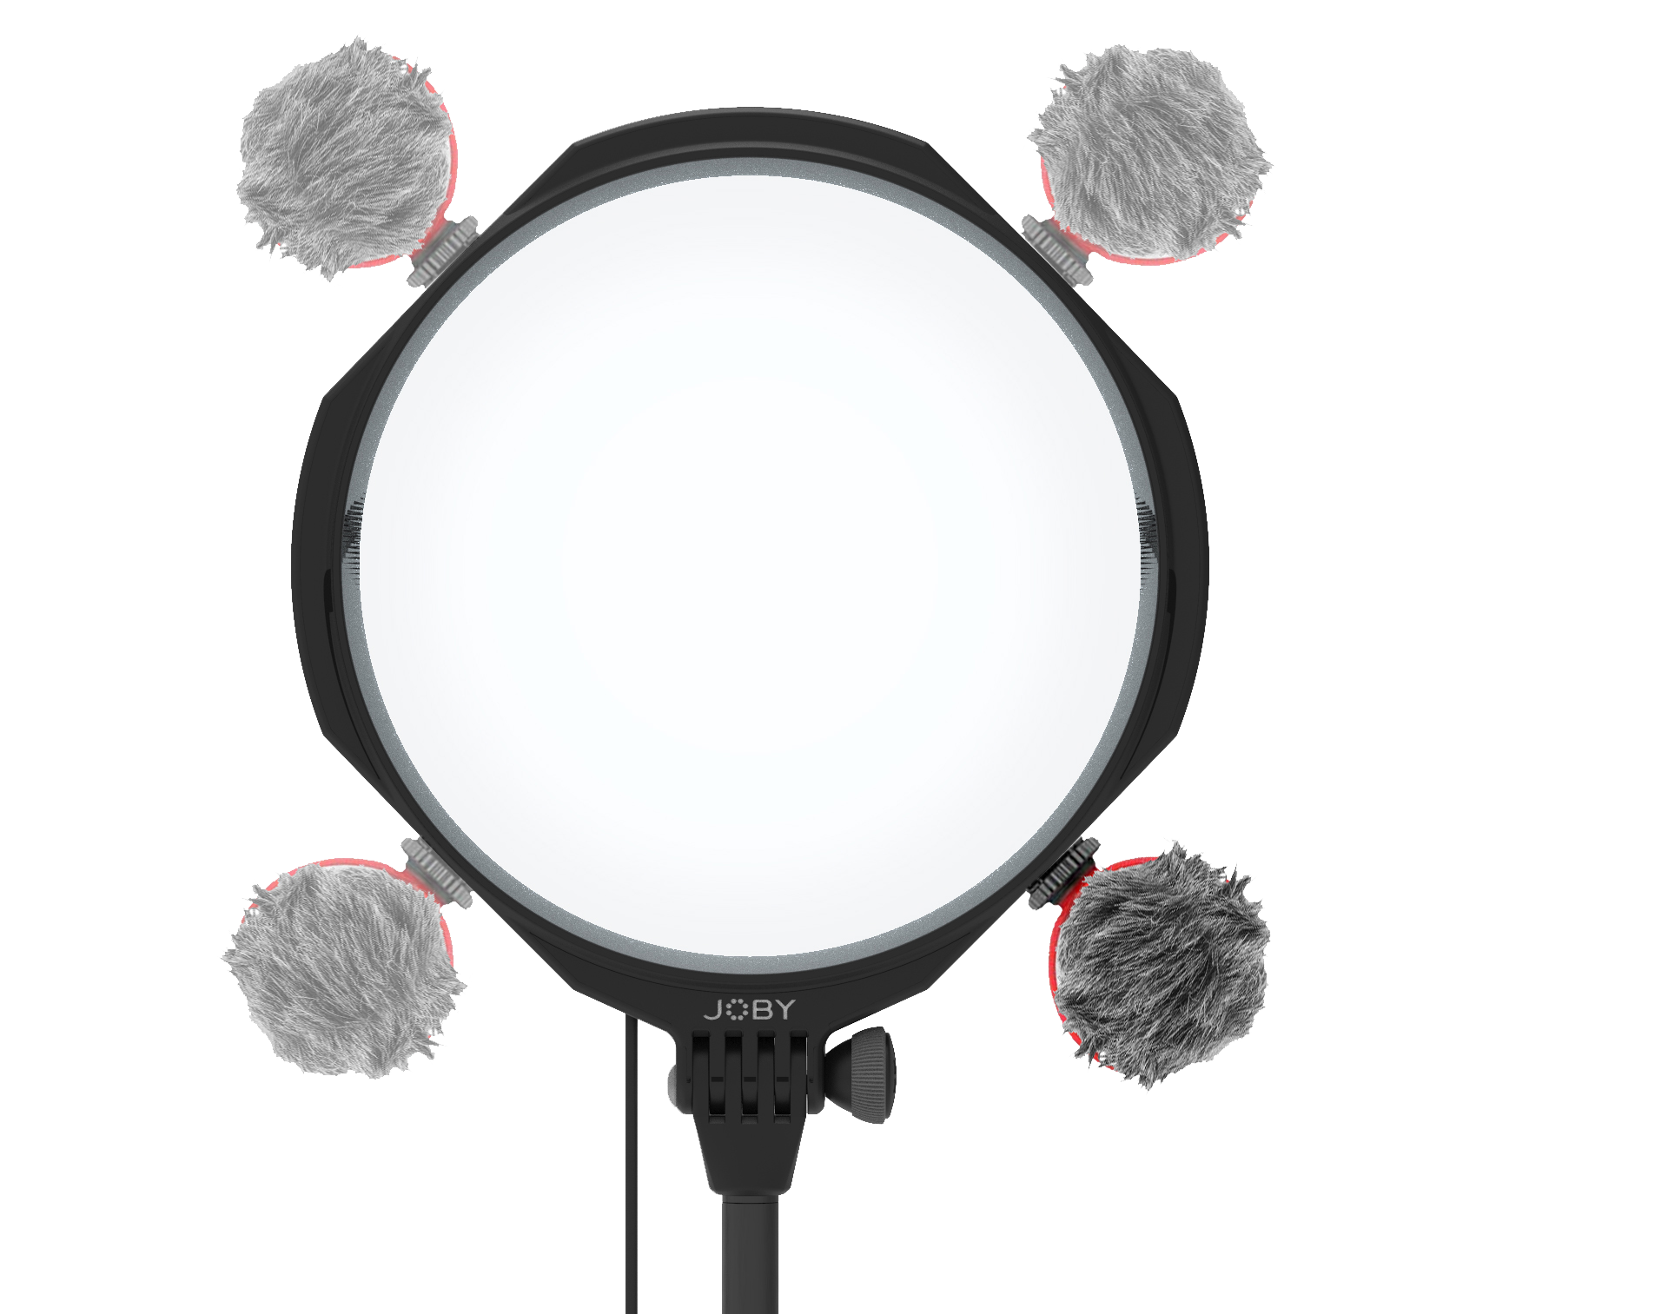
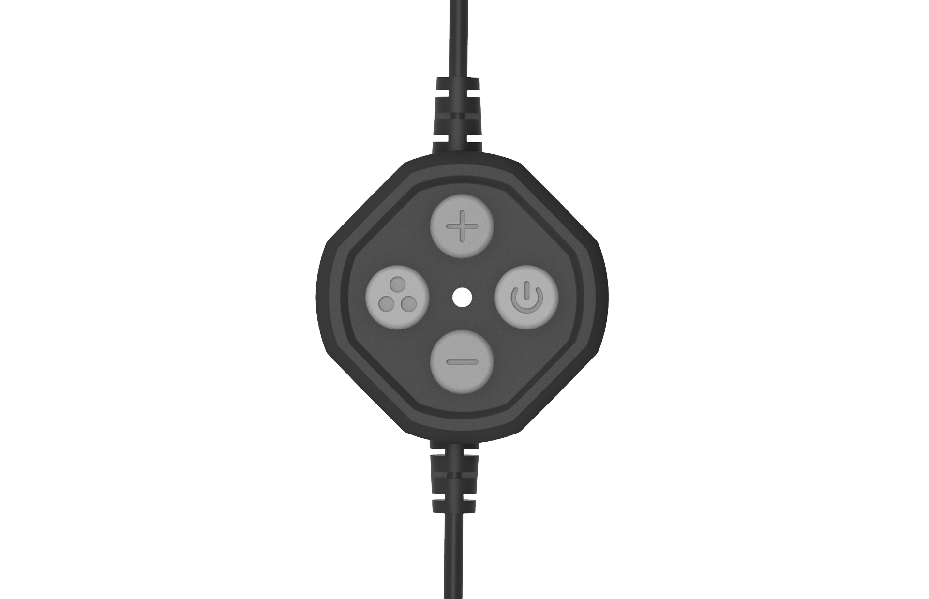
JOBY Beamo™ Studio Key Light
Slim profile, super soft LED key light for your YouTube home studio
JB01861-BWW
Sell Sheet
10 brightness levels
and 3 color temperature for best result
The LED studio key light that makes you look good in your YouTube videos.
The Beamo™ Studio Key Light is a slim profile, soft main light for your home video studio providing great adjustability to up your content creation game.
Create engaging contents with the easy-on-eyes key light. Built-in Soft-Lens light diffusion ensures you will get the best image quality for your talking head videos. 10 brightness levels and 3 color temperature can be controlled by the supplied cable remote which also magnetically attaches to the base of the table stand. Cold shoes can be found around the light for adding a Wavo™ mic to improve audio quality.
The table stand allows the key light to tilt and be raised to ideal height (68-95cm/27-37") for the shoot. Small footprint makes it perfect for small spaces. It's also a very capable desktop LED light for video calls when you are not creating content.
Can be used standalone or buy two to create 2-point lighting, this key light will for sure make you shine in your next video!
Materials: ABS
Lux @ 0.5m: 650 ±10%
What’s in the box: Key light, table stand
Soft, easy-on-eyes
key light
to create engaging contents
Supplied cable remote
For easy control of the key light
Multiple cold shoes around the light for easy mic attachment

