Slide 1
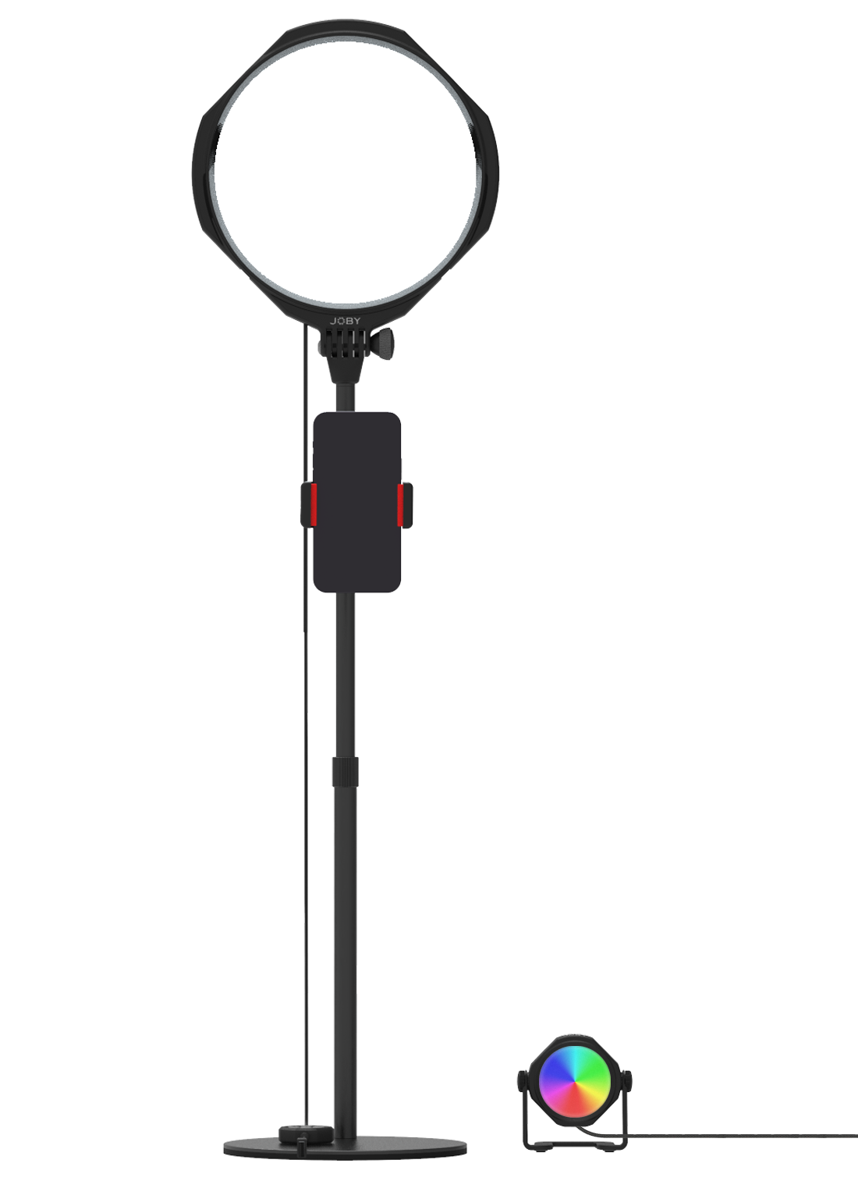
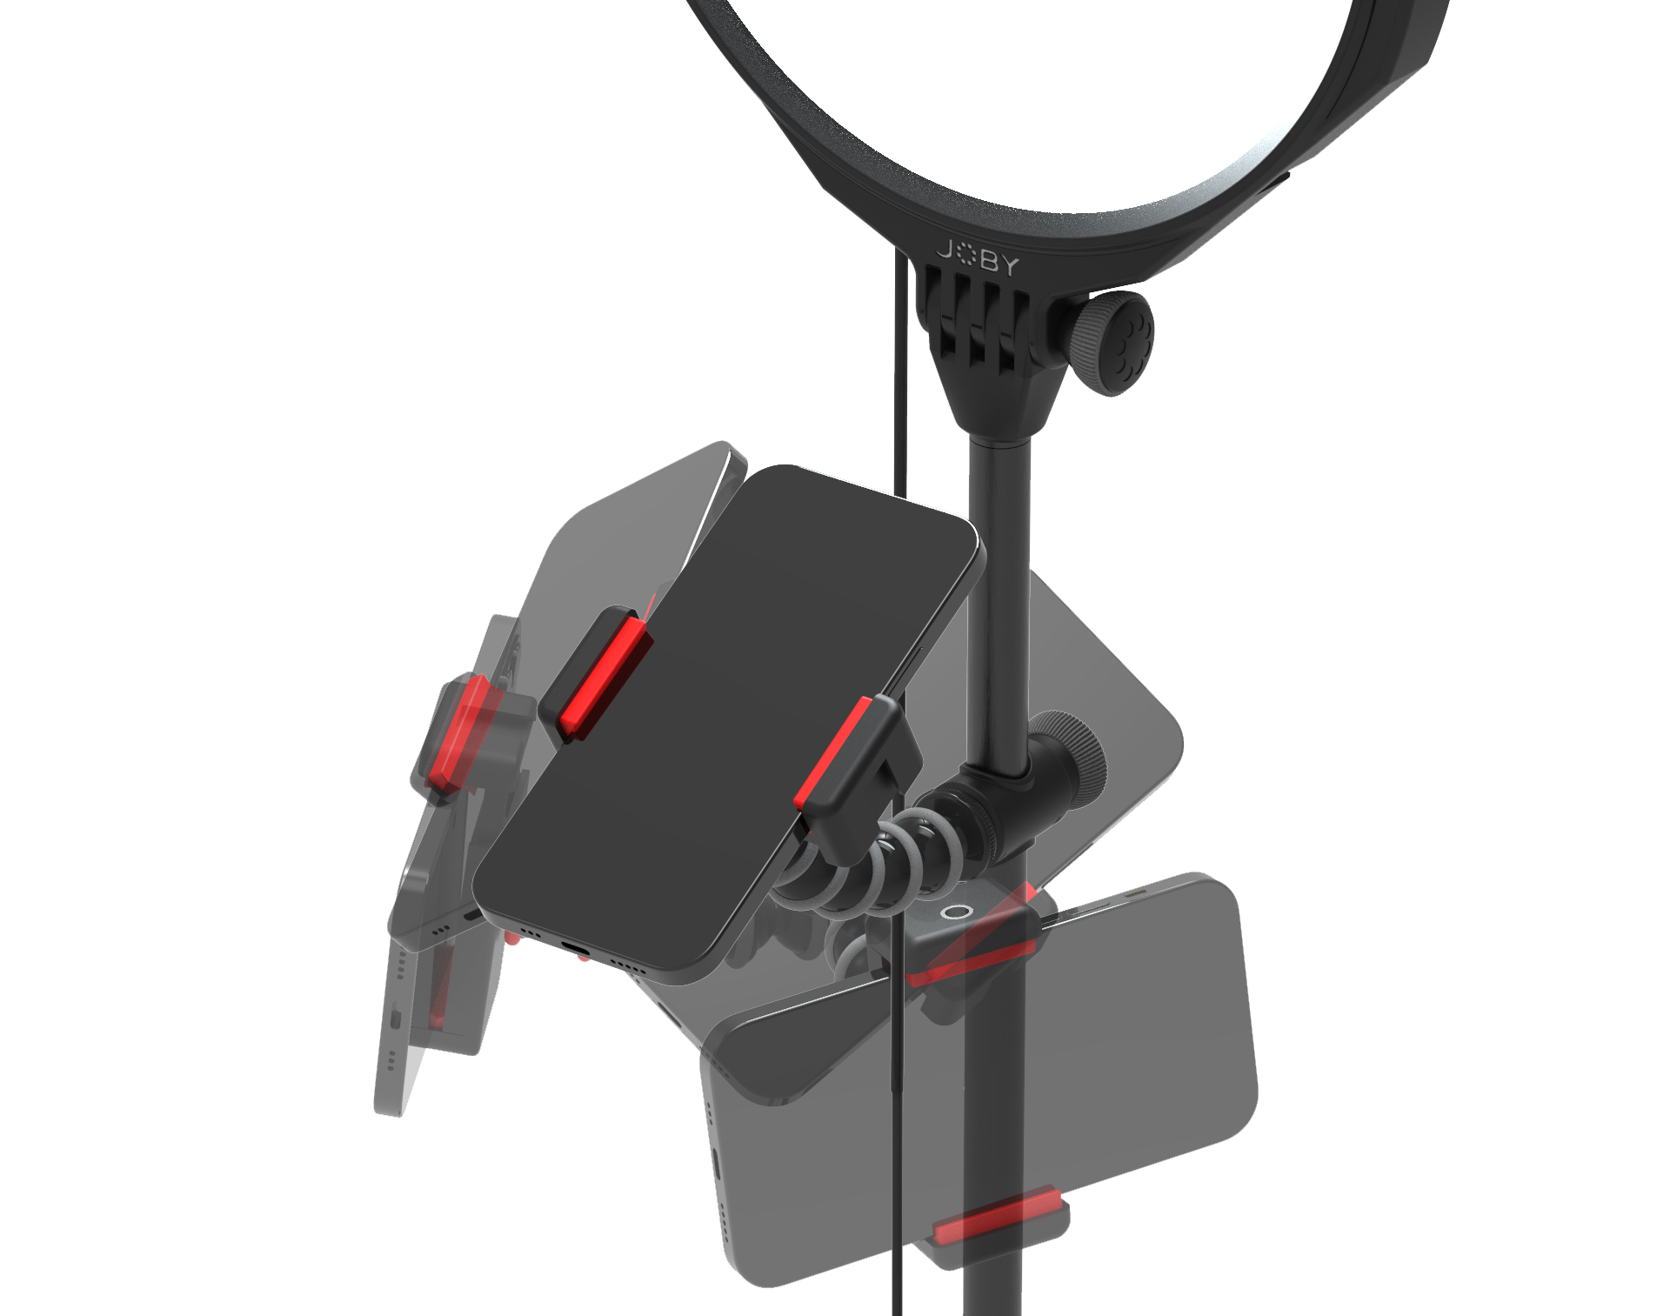
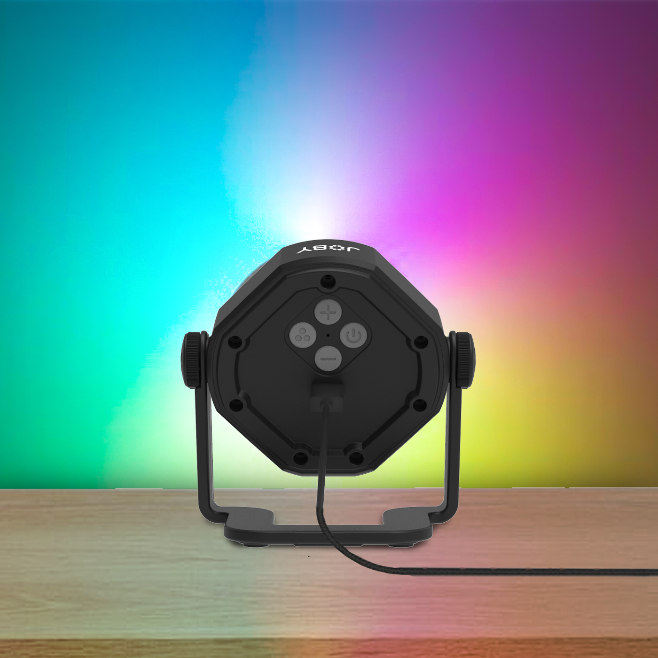
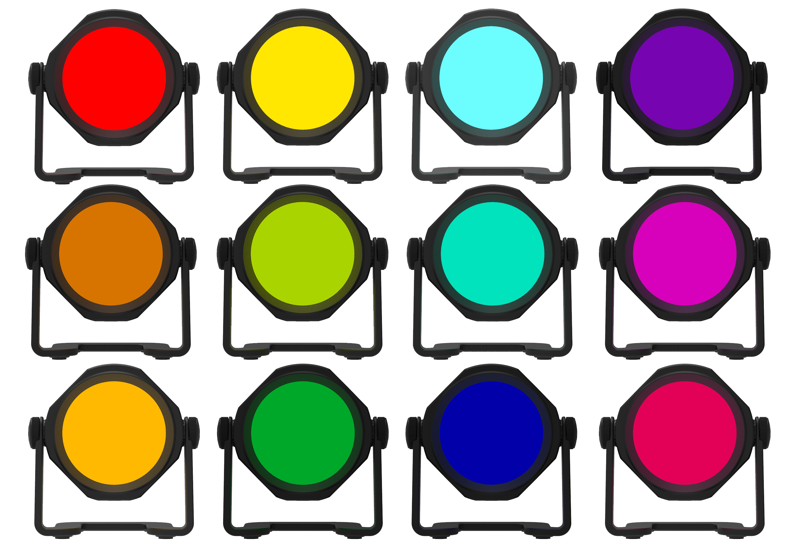
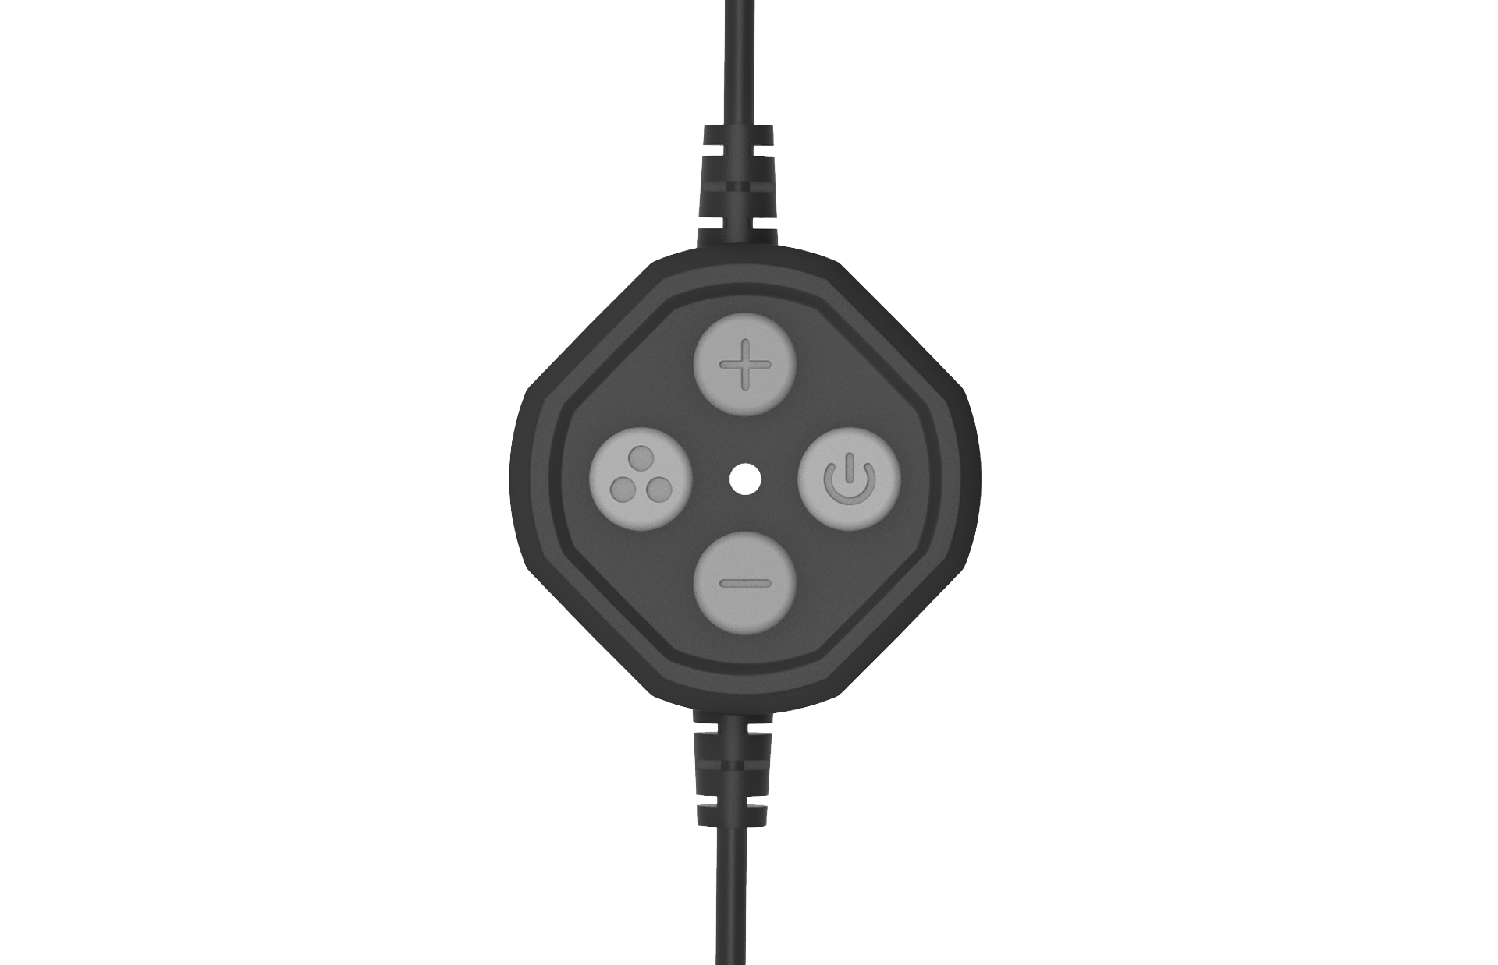
JOBY Beamo™ Studio Deluxe Lighting Kit
One-stop YouTube home studio lighting kit with LED key light and background light
JB01834-BWW
Sell Sheet
All you need to light up your first YouTube home studio.
The Beamo™ Studio Deluxe Lighting Kit is a one-stop lighting solution for your home video studio including a key light and a color background light to get your channel started.
Create engaging contents with the easy-on-eyes Beamo™ Studio Key Light. Built-in Soft-Lens light diffusion ensures you will get the best image quality for your talking head videos. 10 brightness levels and 3 color temperature can be controlled by the supplied cable remote which also magnetically attaches to the base of the table stand.
The table stand allows the key light to tilt and be raised to ideal height (68-95cm/27-37") for the shoot. The phone mount is supported by a flexible GorillaPod® Arm for easy angling and framing. Cold shoes can be found on the key light and the phone mount if you wish to add a Wavo™ mic to improve audio quality.
Finally, make your videos stand out by adding color to your background with the multi-angle, 10 brightness levels and 12 colors adjustable Beamo™ Studio Background Light.
Both lights are USB-powered.
Materials: ABS, Stainless steel, TPE
Lux @ 0.5m: Key: 650 ±10% Background:90 (Red color) ±10%
What’s in the box: Key light, table stand, phone mount, flexible arm, background light & USB power cable
Flexible
GorillaPod® Arm
for easy phone angling and framing
Soft, easy-on-eyes
key light
to create engaging contents
Supplied cable remote
For easy control of the key light
12 background light color options to make your videos stand out

