Slide 1
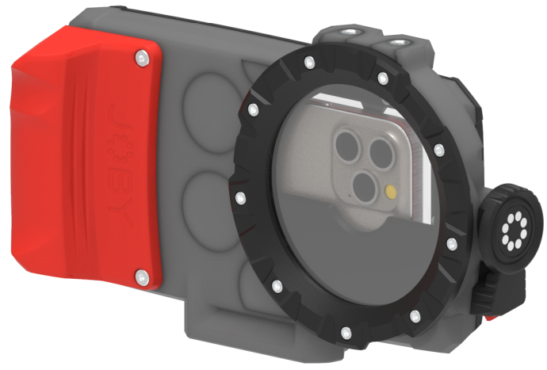
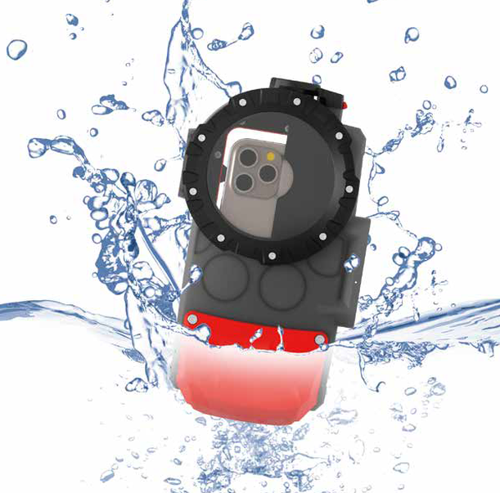
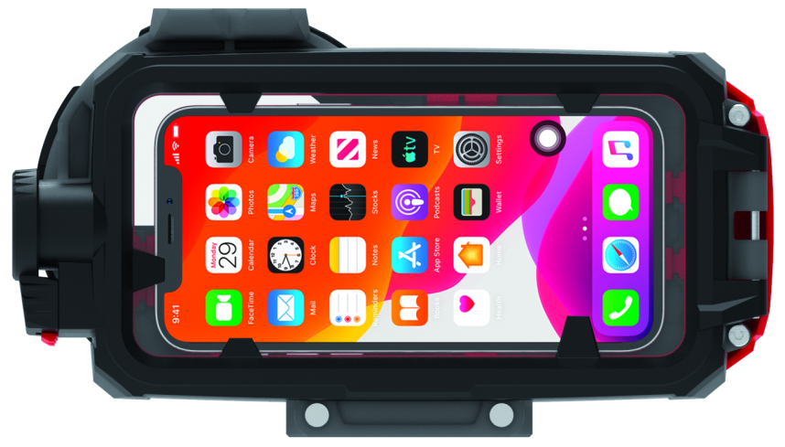
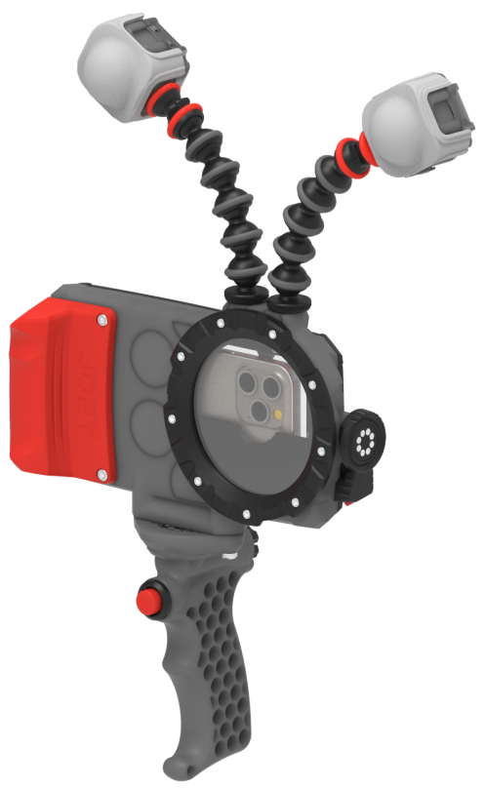
JOBY SeaPal Waterproof Case
Waterproof Phone Case for Action Content Creation
JB01948-BWW
Sell Sheet
The ultimate Smartphone waterproof, shockproof and dustproof housing, SeaPal is the tool you need to get in the water and give your content the WOW factor you’ve always wanted. Never miss any opportunities leaving your phone behind on the boat, shore or by the pool worried about water damage, let SeaPal transform the way you think about capturing the underwater moments you’ve always dreamed of using the camera you already know and love.
JOBY has partnered with AquaTech, who has been making water housings for the world’s best ocean photographers for over 20 years. We took all of that knowledge and experience and created SeaPal. Whether you're surfing, snorkeling, fishing, freediving, kayaking or just taking photos of the kids in the backyard pool, the SeaPal protects your phone and lets you focus on getting the perfect shot.
Take your content creation to new levels with SeaPal and your phone. SeaPal supports all the latest features of the iPhone and Samsung Galaxy S series phones. No 3rd party apps required. Just use your phone, your way.
Materials Glass Filled Polycarbonate, Stainless Steel, Glass, TPU
Dimensions: 14x6x24cm(5.3x2.5x9.5in)
Net Weight: 570g (1.26 lbs)
Manufacture Warranty One Year Warranty
Beamo-
Compatible
Two 1/4"-20 accessory ports for Beamo lights
Universal fits
all iPhone 15, 14,13*,12,Samsung Galaxy S23,22 models
Waterproof
Depth rated to 10m/33ft with glass lens port
Full touchscreen access
supports iPhone's Macro & Cinematic Mode, RAW
Ecosystem
Optional accessories: 6” dome port, Bluetooth shutter grip and sports leash
*Excluding iPhone 13 Mini

Slide 2
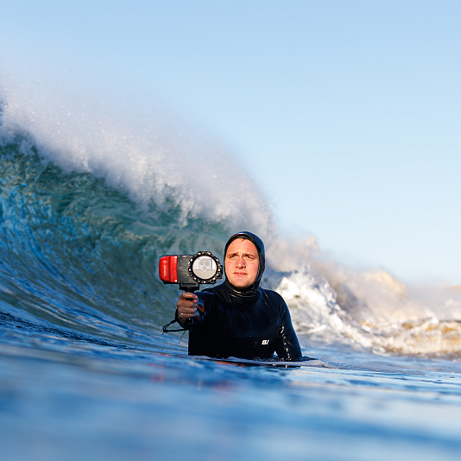
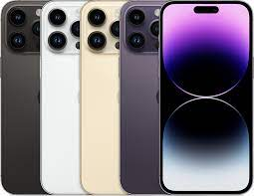
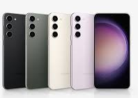
JOBY SeaPal
Sales Deck
Target Audience
Primary Target
Outdoor Lifestyle/Sports/
Adventure Hobbyists
Surfing, snorkeling, fishing, freediving, kayaking, etc.
Secondary Target
Expert Travel Creator
Travel vlogger, travel YouTuber, travel blogger, etc.
Target Device
iPhones
15/14/13*/12 all models
Samsung
Galaxy S23/22 all models
*Excluding iPhone 13 Mini

