Slide 1
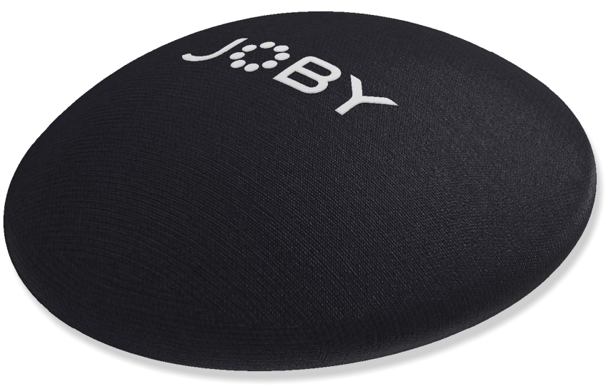
JOBY SeaPal 6" Dome Cover
Protective Cover for SeaPal 6" Dome
JB01952-BWW
Sell Sheet
The SeaPal 6" Dome Cover is the perfect choice for SeaPal 6" Dome protection and care. The SeaPal Dome Cover is designed to protect the element from damage whilst the port is either on the waterproof case or not in use.
Made from 4.5mm, High Stretch neoprene, with a tough, highly abrasion resistant Nylon Jersey, laminated inside and out. The neoprene cover neatly stretches over your valuable dome and all-important elements, from uninvited shocks and sharp objects.
Covers can be cleaned and washed in cold soapy water, rinse and air dry.
JOBY has partnered with AquaTech, who has been making water housings for the world’s best ocean photographers for over 20 years. We took all of that knowledge and experience and created SeaPal. Whether you're surfing, snorkeling, fishing, freediving, kayaking or just taking photos of the kids in the backyard pool, the SeaPal protects your phone and lets you focus on getting the perfect shot.
Materials Neoprene
Dimensions: 19x1x19cm(7.5x0.4x7.5in)
Net Weight: 50g (0.11 lbs)
Manufacture Warranty One Year Warranty
Protects
your SeaPal 6" Dome
Easy
to Install
High Stretch
Neoprene material
Ready to go
Comes with all mounting hardware

