Slide 1
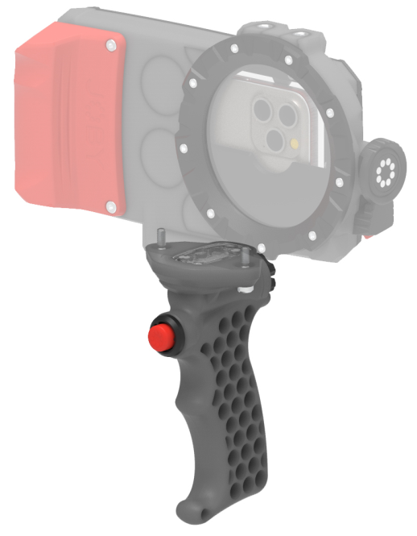
JOBY SeaPal Bluetooth Shutter Grip
Remote Shutter Grip for SeaPal Waterproof Case
JB01950-BWW
Sell Sheet
The SeaPal Bluetooth® Shutter Grip adds superior control over your phone so you never miss a shot. It is designed to provide better responsiveness and feedback through the round shutter button. The ergonomic design of the grip mean it is comfortable and feels secure in your hands. It securely mount your SeaPal Phone Case with 2 screws. Durable Polycarbonate Construction makes it not only waterproof, dustproof, shockproof but also long lasting.
The SeaPal Bluetooth® Shutter Grip is simple to connect to your phone and has a battery life that will allow years of use before needing to be changed.
JOBY has partnered with AquaTech, who has been making water housings for the world’s best ocean photographers for over 20 years. We took all of that knowledge and experience and created SeaPal. Whether you're surfing, snorkeling, fishing, freediving, kayaking or just taking photos of the kids in the backyard pool, the SeaPal protects your phone and lets you focus on getting the perfect shot.
Materials
Glass Filled Polycarbonate, Stainless Steel
Dimensions: 15x9x8cm(5.8x63.5x3in)
Net Weight: 170g (0.37 lbs)
Manufacture Warranty
One Year Warranty
Waterproof
dustproof, shockproof
Securely
mount to your SeaPal Phone Case
Intuitive
point and shoot control
Durable
polycarbonate construction
Remote triggers
camera shutter of the phone in the SeaPal case

