Slide 1
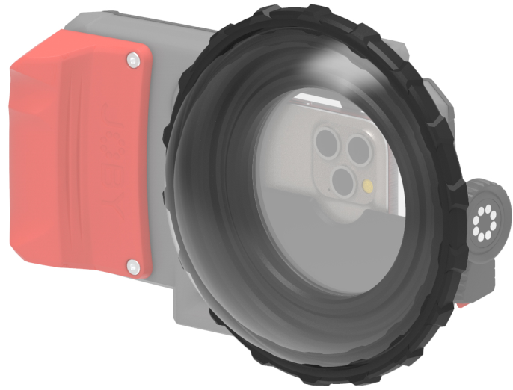
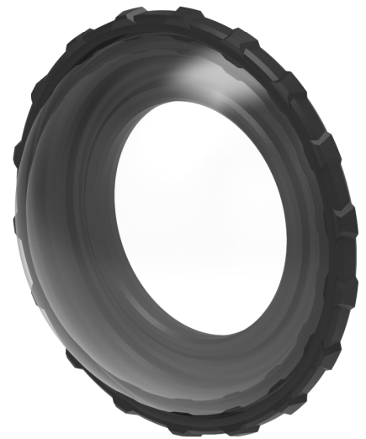
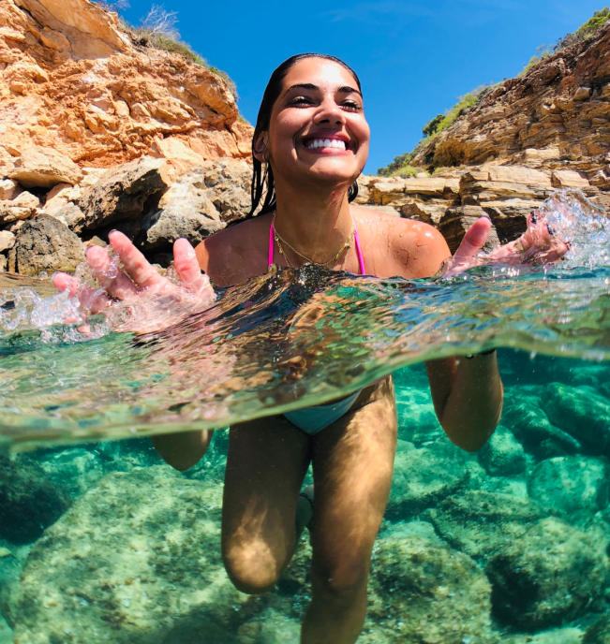
JOBY SeaPal 6" Dome
Dome Port for SeaPal Waterproof Case
JB01949-BWW
Sell Sheet
Take your smartphone photography to the next level with the SeaPal Dome. The SeaPal Dome is a 6” acrylic dome that connects to your SeaPal Waterproof Case. With the SeaPal Dome installed on your SeaPal Waterproof Case, you can capture crystal clear underwater images as well as the ever popular over/under style images where you can see above and below the waters surface at the same time.
The SeaPal Dome supports the new Ultra Wide Lens* on the latest phone models allowing you to push the boundaries of underwater photography straight from your phone.
JOBY has partnered with AquaTech, who has been making water housings for the world’s best ocean photographers for over 20 years. We took all of that knowledge and experience and created SeaPal. Whether you're surfing, snorkeling, fishing, freediving, kayaking or just taking photos of the kids in the backyard pool, the SeaPal protects your phone and lets you focus on getting the perfect shot.
Materials
Acrylic, Glass Filled Polycarbonate
Dimensions: 11x18x18cm(2.8x6.5x6.5in)
Net Weight: 230 (0.51 lbs)
Manufacture Warranty
One Year Warranty
Full Access
for Phone Lenses
Optically Correct
for under/over water shooting
6” (15cm) Acrylic
Dome for easy split of water
Split Water
Shoot Over/Under style contents
Lightweight
and easy to install
*Slight vignette when using the ultra-wide lens on certain phones might occurs. Zooming in slightly removes the vignette

