Slide 1
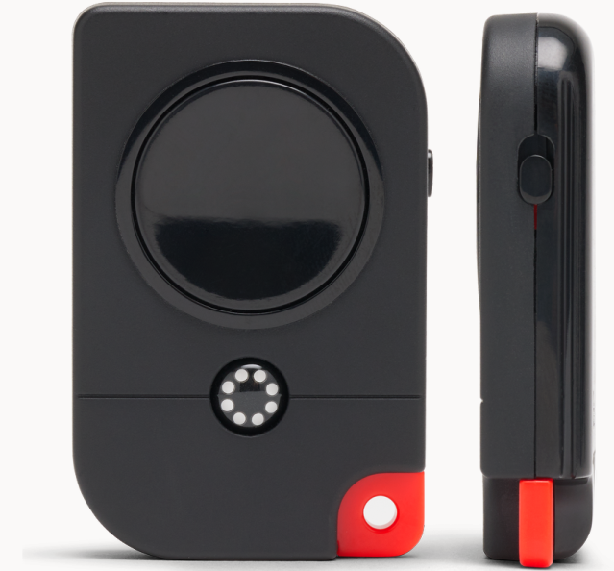
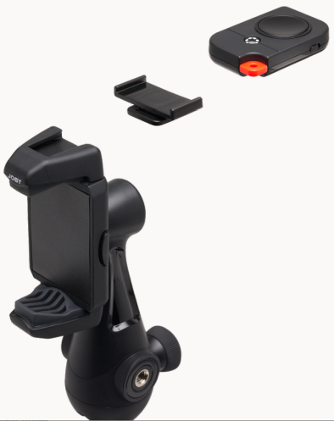
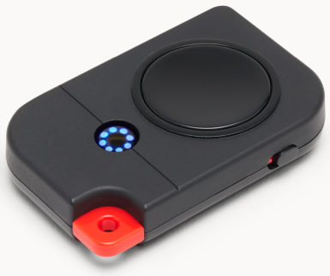
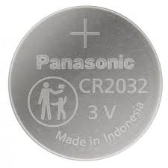
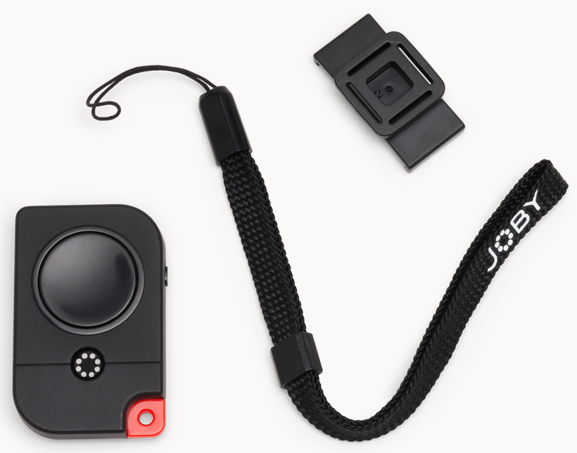
JOBY Impulse™ 2
Premium Bluetooth 5.0 remote trigger with dual buttons for latest smartphones
JB01751-BWW
Sell Sheet
Impulse™ 2 smartphone Bluetooth® remote trigger is designed to work with JOBY GripTight™ collection products, enabling you to start record on your iPhone, iPad & Android devices wirelessly.
Powered by Bluetooth 5.0, this remote trigger works with most of the latest phone, allowing you to hit record as far as 25m (80ft) away and is feature packed. Big shutter button makes sure you don't lose a moment for your Vlog. The JOBY flower logo doubles as a 2-color status LED indicator guides you to connect and operate the remote easily. Dedicated on/off switch together with the status indicator allows hassle-free operation and save battery as well.
The included lanyard keeps it on your wrist whenever you need it. It can be stored on top of any cold shoe of our GripTight mounts when not in use through the supplied cold shoe adapter.
Complete your mobile creation kit with the Impulse 2 today, go create and have fun!
Materials: ABS
Dimensions: 1.7 x 5 x 3.5cm (0.67 x 1.97 x 1.38in)
Net Weight: 15g (0.03 lbs)
Certified Bluetooth 5.0
technology works up to 25m (80 ft) away
cold shoe adapter
and wrist strap included for easy carrying
Dual buttons
and 2-color LED indicator for easy operations
No App Required
and uses a common, replaceable CR2032 battery

