Slide 1
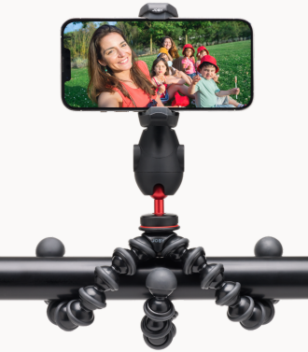
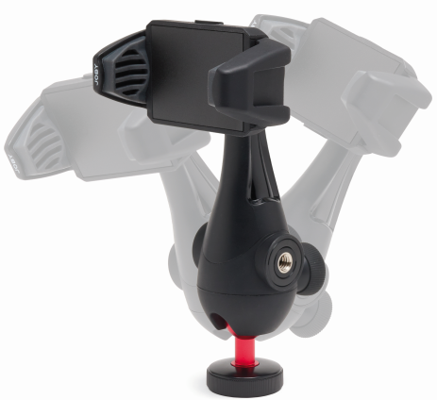
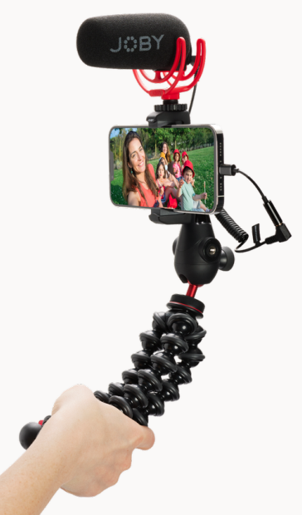
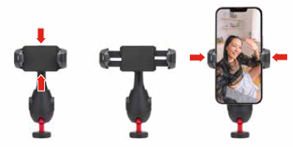
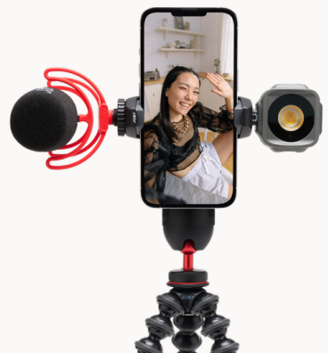
JOBY GripTight™ PRO 3 GorillaPod
Flagship flexible phone tripod kit with leveling phone mount and GorillaPod
JB01740-BWW
Sell Sheet
The GripTight PRO 3 GorillaPod is a mobile Vlogging tripod designed to help professional content creators to record epic Vlogging contents and grow their channel in no time.
The base of this kit, the mighty GorillaPod® 1K Stand allows you to get the best possible shooting angles for your daily vlog. Can be setup in 3 modes: Grip It, Wrap It or Stand It, all will save you a lot of time during your hectic shooting day.
The included GripTight­™ PRO 3 Mount securely mounts your phone with its easy to use yet secure pinch to lock clamp, so you won't miss any critical moment of life for your contents. The clamp rotates 360 degrees with 8 stop positions allowing you to set your phone in the best possible angles.
You can level and frame your shots easily with the built-in mini metal ball head on the bottom part of the mount. When situation requires, add an external microphone and/or LED light to the 2 cold shoes on the clamp for better audio and picture quality. The two 1/4"-20 threads on the body give you extra mounting options for additional accessories through the optional GorillaPod Arms.
Built with solid glass-filled nylon and high-grade ABS plastic, the GripTight PRO 3 GorillaPod is your professional choice of tripod for your phone in any condition, from in house to outdoor thanks to its versatility and durability.
Supports phone width: 56-90mm (2.2-3.5")
Materials: Glass Filled Nylon, ABS
Dimensions: 36.8 x 8.5 x 5.5cm (14.49 x 3.35 x 2.17in)
Net Weight: 320g (0.72 lbs)
Flexible legs
secure the phone virtually anywhere
Built-in ball head
for maximum leveling and framing flexibility
Pinch to lock clamp
Simple and secure for quickest deployment
Two cold shoes
for easy light and mic attachment

