Slide 1
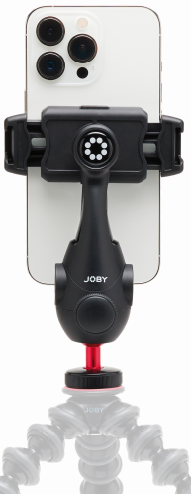
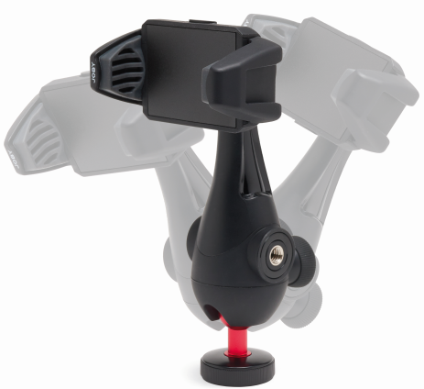
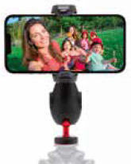
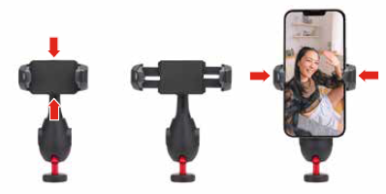
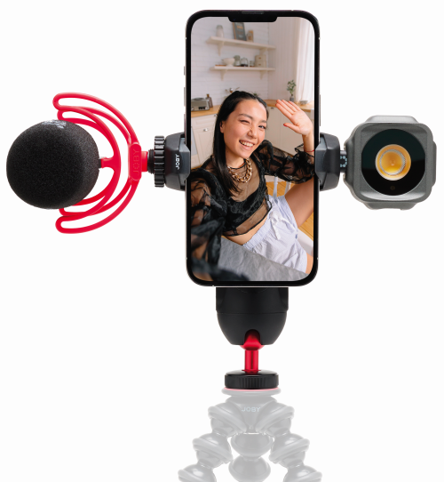
JOBY GripTight™ PRO 3 Mount
Pro-grade phone clamp with built-in ball head and pinch to lock mechanism
JB01739-BWW
Sell Sheet
The GripTight PRO 3 Mount is designed for professional content creator to secure their phone on their own GorillaPod®, HandyPod™, Compact™ or any other tripods for their epic Vlogging contents.
This phone mount securely mounts your phone on a tripod with its easy to use yet secure pinch to lock clamp, so you won't miss any critical moment of life for your contents. The clamp rotates 360 degrees with 8 stop positions allowing you to set your phone in the best possible angles.
You can level and frame your shots easily with the built-in mini metal ball head on the bottom part of the mount. When situation requires, add an external microphone and/or LED light to the 2 cold shoes on the clamp for better audio and picture quality. The two 1/4"-20 threads on the body give you extra mounting options for additional accessories through the optional GorillaPod Arms.
Built with solid glass-filled nylon the GripTight PRO 3 Mount is your professional choice of phone mount for your phone in any condition, from in house to outdoor thanks to its versatility and durability.
Supports phone width: 56-90mm (2.2-3.5")
Materials: Glass Filled Nylon
Dimensions: 16.3 x 8.5 x 4cm (6.42 x 3.35 x 1.57in)
Net Weight: 140g (0.3 lbs)
Glass-filled nylon construction
Super sturdy for maximum durability
Built-in ball head
for maximum leveling and framing flexibility
Pinch to lock clamp
Simple and secure for quickest deployment
Two cold shoes
for easy light and mic attachment

