Slide 1
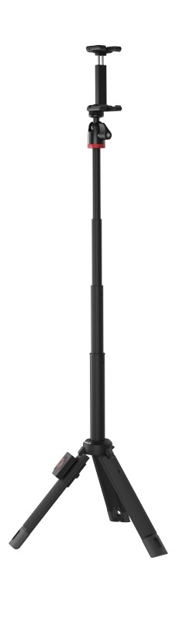
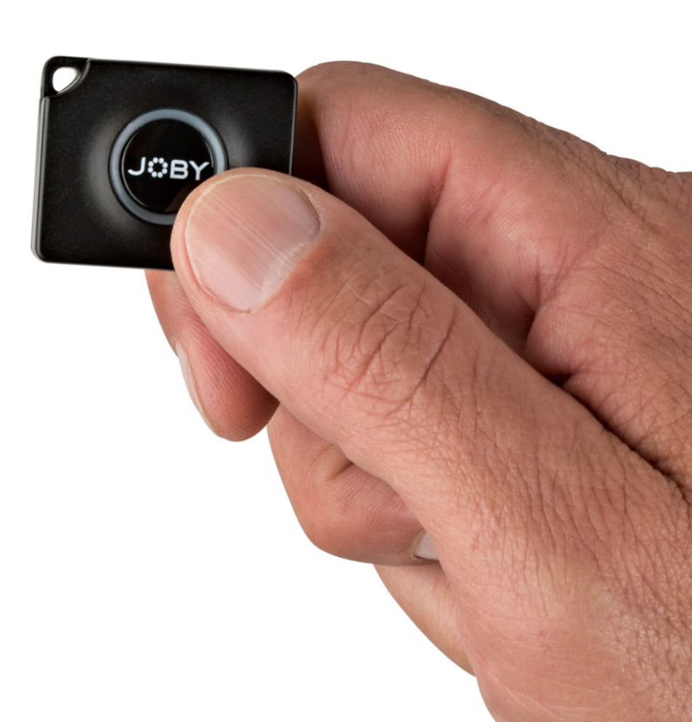
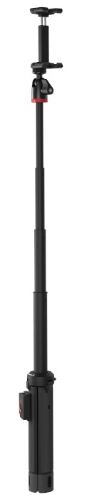
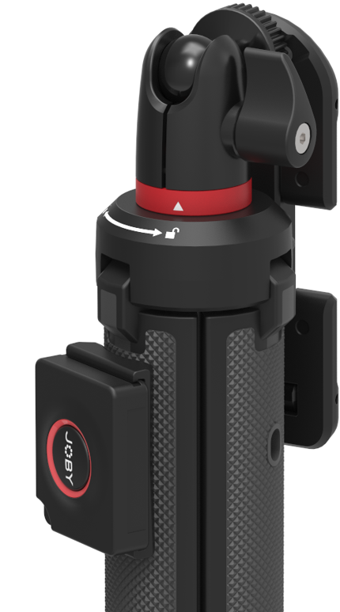
TelePod Mobile
All in one selfie stick tripod for mobile
Designed for Mobile. Works in 3 modes: With legs closed to form a grip and the mount extended, it’s a selfie stick or monopod for overhead shots. With the mount telescoped and legs extended it’s an elevated stand. With legs folded out and the extension lowered, it’s a stable tripod.
Designed for: Mobile Phones, Point & Shoot, 360, Action Cameras, up to 325g (0.7lbs)
Connection: ¼”-20, Universal phone mount.
Materials: Glass filled Polyarylamide, ABS Plastic, Anodized Aluminum, Stainless Steel, TPE
Colors: Black/Grey
Product Weight: 6.6oz / 189g
Weight Capacity: 325g
Product Dimensions
(WxDxH) 3.8 x 6 x 19 cm
1.5 x 2.4 x 7.5in
Manufacture Warranty
One Year Warranty
Works as monopod, elevated stand or tripod.
Smaller version of GripTight PRO TelePod, supplied with GripTight One Mount for mobile vlogging & selfie stick. Also works as stationary stand.
325g capacity covers entire phone market. Also fits small 360 camera, or phone with 360 camera attachment.
Durable Construction: Glass filled composite is lightweight and high strength with thinner structure.
Stable: Extendable: Tripod telescopes from 19-61cm.
Precise positioning with included ballhead.
Modular: Works with JOBY’s mounts including GripTight ONE (Included), GoPro mount, Flash mount, or any ¼-20” device under 325g.
Includes JOBY Impulse Bluetooth shutter and removable mount. .

