Slide 1
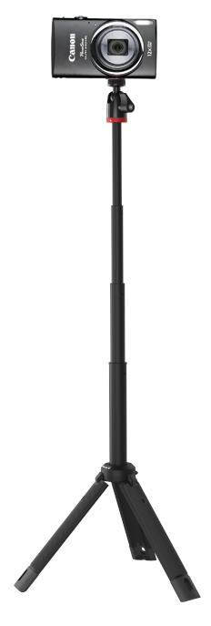
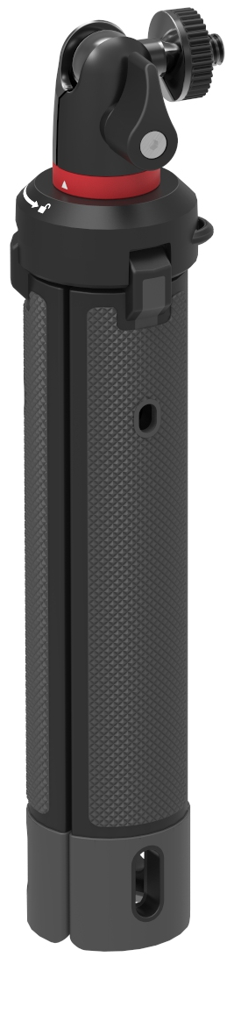
TelePod 325
All in one selfie stick tripod for Point & Shoot and Small 360 Cameras.
Compact version of the TelePod Pro. Works in 3 modes: With legs closed to form a grip and the mount extended, it’s a selfie stick or monopod for overhead shots. With the mount telescoped and legs extended it’s an elevated stand. With legs folded out and the extension lowered, it’s a stable tripod.
Designed for: Point & Shoot, 360, Action Cameras, up to 325g (0.7lbs)
Connection: ¼”-20
Materials: Glass filled Polyarylamide, ABS Plastic, Anodized Aluminum, Stainless Steel, TPE
Colors: Black/Grey
Product Weight: 5.6oz / 159g
Weight Capacity: 325g
Product Dimensions
(WxDxH) 3.8 x 3.8 x 19 cm
1.5 x 1.5 x 7.5 in
Manufacture Warranty
One Year Warranty
Works as monopod, elevated stand or tripod.
Smaller version of TelePod Pro Kit, for mobile vlogging & selfie stick. Also works as stationary stand.
325g capacity, fits popular Point & Shoot cameras, small 360 camera, phone or phone with 360 camera attachment.
Durable Construction: Glass filled composite is lightweight and high strength with thinner structure.
Stable: Extendable: Tripod telescopes from 19-61cm.
Modular: Works with JOBY’s mounts including GripTight ONE (Included), GoPro mount, Flash mount, or any ¼-20” device under 325g.
Includes removable mount for JOBY Impulse Bluetooth shutter.

