Slide 1
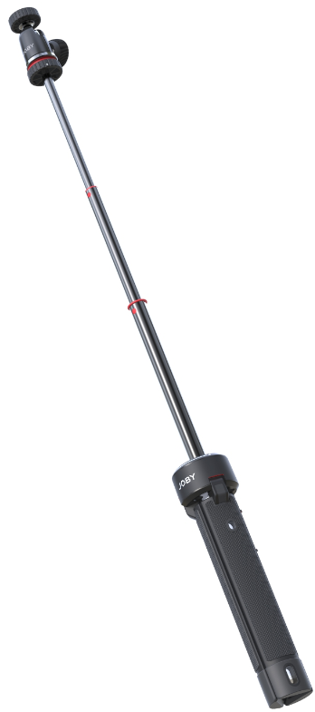
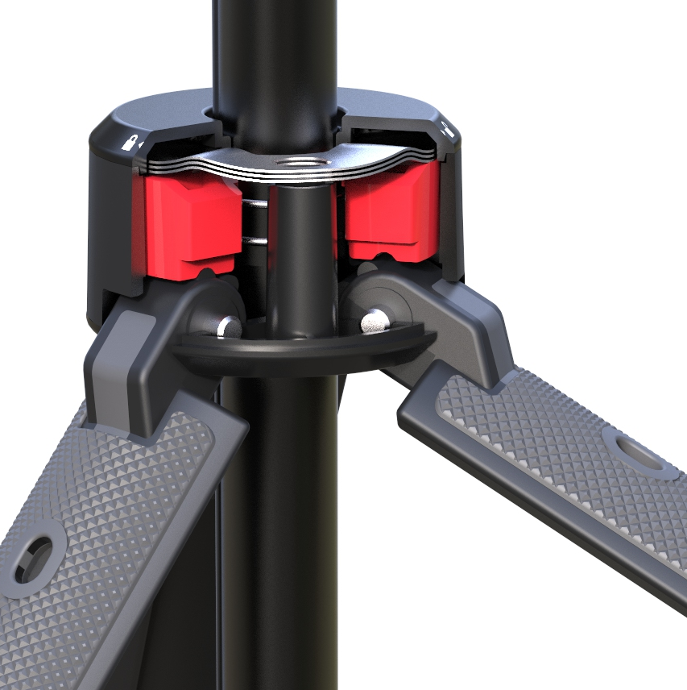
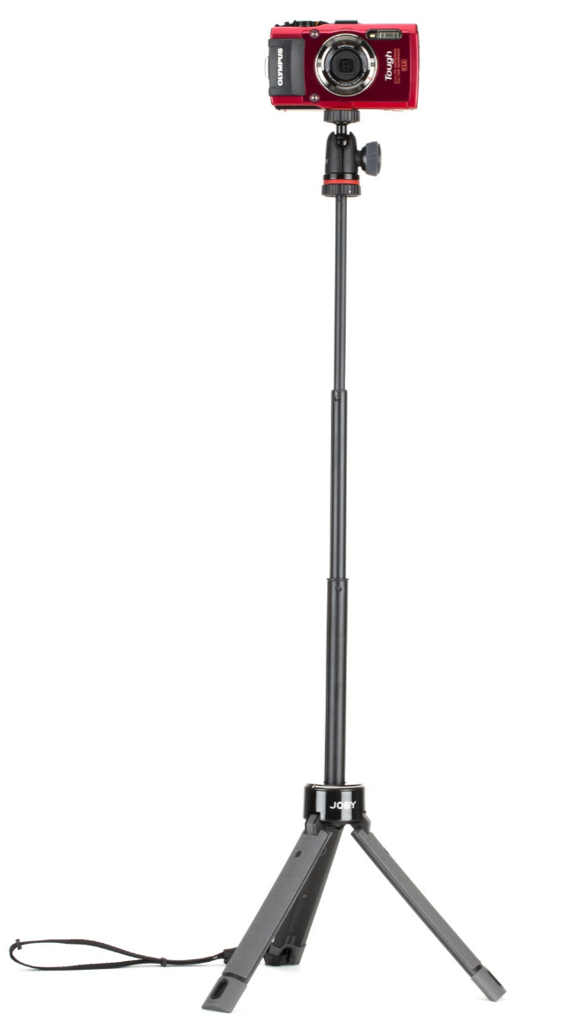
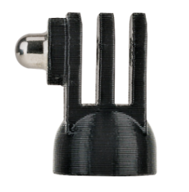
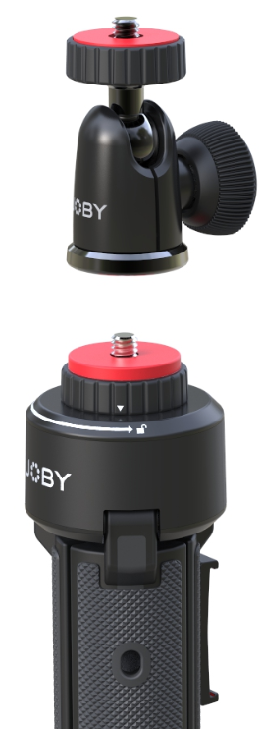
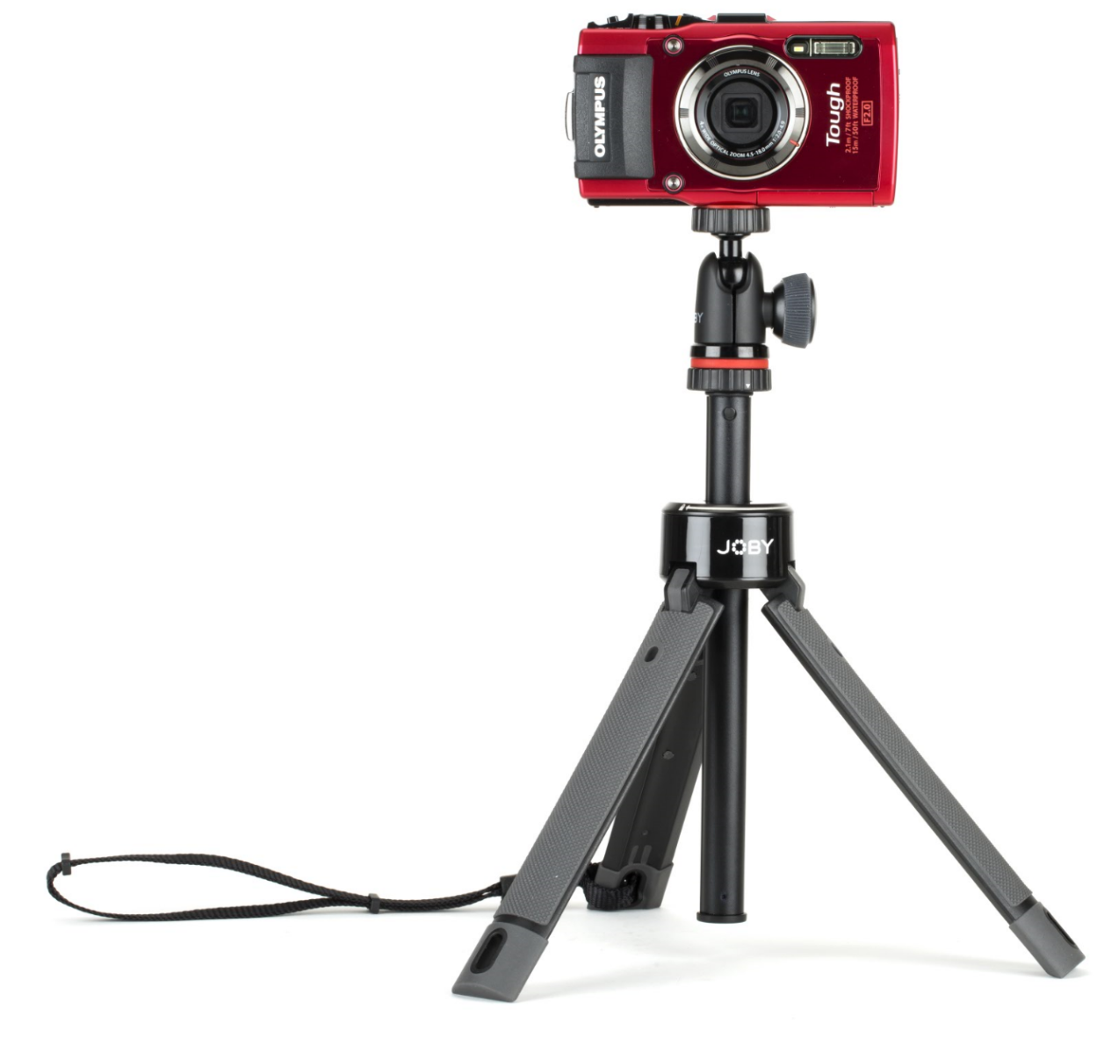
TelePod PRO Kit
A Pro-Level Camera Selfie Platform & Ballhead.
Works in 3 modes: With legs closed to form a grip and the mount extended, it’s a selfie stick or monopod for overhead shots. With the mount telescoped and legs extended it’s an elevated camera/360 stand. With legs folded out and the extension lowered, it’s a stable camera tripod.
Designed for: Mirrorless, Point & Shoot, 360, Action Cameras, Phone/Tablet or light up to 1kg.
Connection: ¼”-20 attachment
Materials: Glass filled Polyarylamide, ABS Plastic, Anodized Aluminum, Stainless Steel, TPE
Colors: Black/Grey
Product Weight: 8.8oz / 244g
Weight Capacity: 1kg
Product Dimensions
(WxDxH) 4 x 4 x 25 cm
1.5 x 1.5 x 10in
Manufacture Warranty
One Year Warranty
Durable Construction: Glass filled composite is lightweight and high strength with thinner structure.
Adjustable Legs: patent pending legs can be click-set in three positions to stabilize heavier cameras on uneven surfaces.
Removable Ballhead: Ballhead 1K can be used on GorillaPod or ¼”-20 tripod mount.
Stable: Flatten legs to max 36cm (14 inches) inch spread for more stability in windy situations.
Extendable: Tripod telescopes from 26-70cm.
Precise positioning: 360 degree panning bed and 90 degree tilt. Get portrait & landscape shots with ease.
Modular: Works with JOBY’s pro-level mounts including GripTight PRO Mounts (Phone and Tablet), GoPro mounts, Microphones and Video lighting.
3-position click-set
Adjustable legs
Removable
Ballhead

