Slide 1
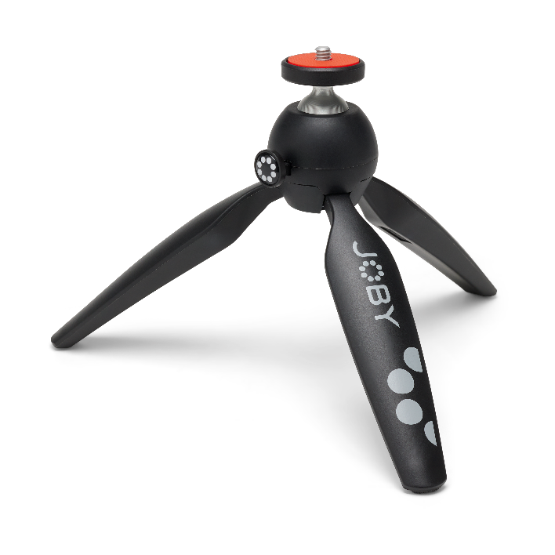
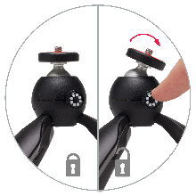
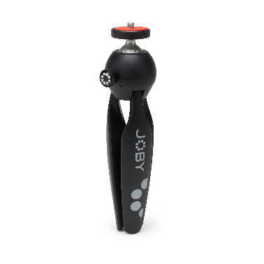
JOBY HandyPod™ 2 Black
Dual Function mini tripod and hand grip for the Content Creator
JB01871–BWW
Sell Sheet
HandyPod is a mini tripod for content creators looking for a lightweight, portable, and easy-to-use support system. It helps you to flawlessly capture challenging video shots that are steady and smooth. Don’t need the tripod legs? Use it with the legs closed to capture professional-looking videos that are sure to stand out. The push-button mechanism enables to position and lock the ball head in one rapid, intuitive movement and to move it into portrait position.
The rubber feet guarantees a stable and slip-free foundation on any surface. Thanks to the universal ¼” screw thread and excellent stability, you can use HandyPod with point and shoot, mirrorless, microphone and other digital devices weighing up to 1 kg / 2.2 lbs.
Designed for: Point & Shoot, Mirrorless Cameras and others hardware up to 1kg / 2.2lbs
Connection: 1/4"-20 Standard Tripod Mount
Materials: Aluminum, Rubber, Technopolymer
Color: Black
Product Weight: 0.17 kg / 0.37 lbs
Weight Capacity: 1 kg / 2.2 lbs
Product Dimensions:
4.2 x 5.3 x 18.5 cm
1.65 x 2.09 x 7.28 in
Manufacturer Warranty: One-Year Limited Warranty
Lock It Down
¼-20” locking wheel mount
Push button adjustability
Dual Function
Dual function: works as a table top tripod or as a handheld support
Solid & Reliable
Support up to 1kg
Premium and durable materials

Slide 2

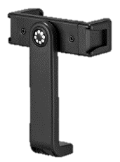

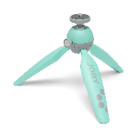
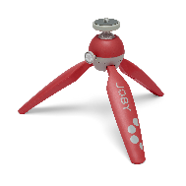
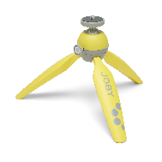
JOBY HandyPod™ 2 Kit
Dual Function mini tripod and hand grip with GripTight 360 for Mobile Content Creator
JB01872–BWW / JB01873-BWW / JB01874-BWW / JB01875-BWW
Sell Sheet
HandyPod is a mini tripod for content creators looking for a lightweight, portable, and easy-to-use support system. Don’t need the tripod legs? Use it with the legs closed to capture professional-looking videos that are sure to stand out. The push-button mechanism enables to position and lock the ball head in one rapid intuitive movement.
The rubber feet guarantees a stable and slip-free foundation on any surface. Thanks to the universal ¼” screw thread and excellent stability, you can use HandyPod 2 with mirrorless, microphone and other digital devices weighing up to 1 kg / 2.2 lbs.
HandyPod 2 Kit is also supplied with the GripTight™ 360 Phone Mount, so grabbing that latest mobile clip for TikTok or IG has never been so accessible to all. The jaws are wide enough to fit phones up to 8.8 cm / 3.46 in. Not to mention, it also comes with as Pin Joint Mount to capture the moment with your Action Cam.
The HandyPod 2 Kit is also available in a range of colors to suit your style.
Designed For: Compact Mirrorless, Bridge Cameras, Smartphones
Connection: ¼-20” with included phone mount
Materials: Plastic, Rubber, Aluminium, Technopolymer
Colour Options: Black / Red / Teal / Yellow
Product Weight: 0.24 kg / 0.53 lbs
Product Dimensions:
tripod 4.2 x 5.3 x 18.5 cm phone mount 4 x 2.4 x 13.6 cm
1.65 x 2.09 x 7.28 in 1.57 x 0.94 x 5.35 in
Manufacture Warranty: One Year Warranty
Lock It Down
¼-20” locking wheel mount
Push button adjustability
Solid & Reliable
Support up to 1kg
Premium and durable materials
Go Mobile Crazy
Include GripTight 360 Phone Mount
Spring loaded rotating design
Add Lights and Mics to double cold shoe mounting points
Durable
Mount action cams with pin-joint to tripods

Slide 3
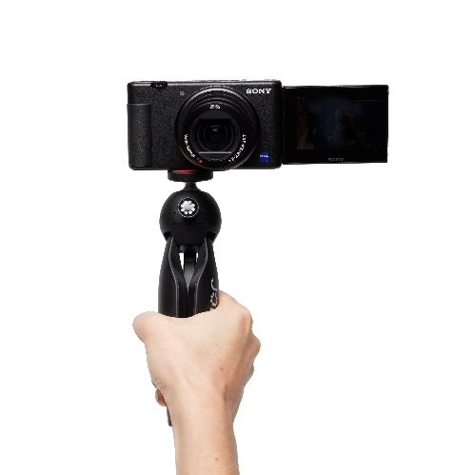
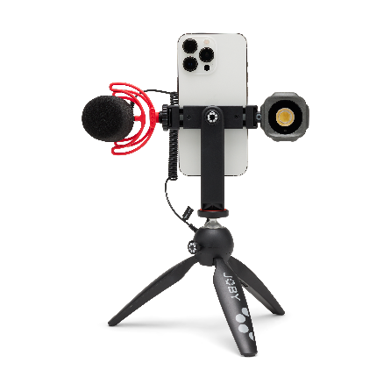
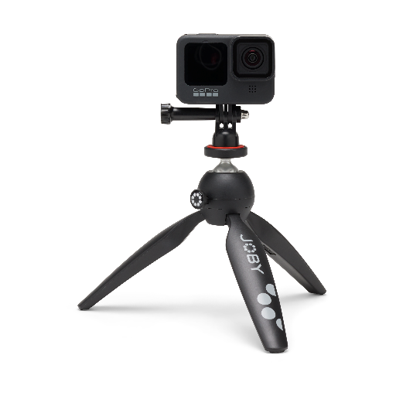
JOBY HandyPod™ 2 Family : Positioning
Dual Function mini tripod and hand grip for the Content Creator
JB01871–BWW / JB01872-BWW / JB01873-BWW / JB01874-BWW / JB01875–BWW
Sales Deck
Twice the Fun
HandyPod 2 is a dual function mini tripod and hand grip for content creators looking for a lightweight, portable, and easy-to-use support system. You can use HandyPod 2 with point and shoot, mirrorless, microphone and other digital devices weighing up to 1 kg / 2.2 lbs.
With various colors to choose from, the HandyPod 2 Kit comes with push button ballhead and included GripTight 360 phone mount and pin joint mount to attach various devices. GripTight 360 allows for a full rotation of 360°, swapping between vertical stories and horizontal pics has never been so simple. We also added cold shoe attachment points on each end of the mount, so adding lights and mics is now an option for every level of creator. The also included Pin Joint Mount allows you to attach action camera with ease.

Slide 4
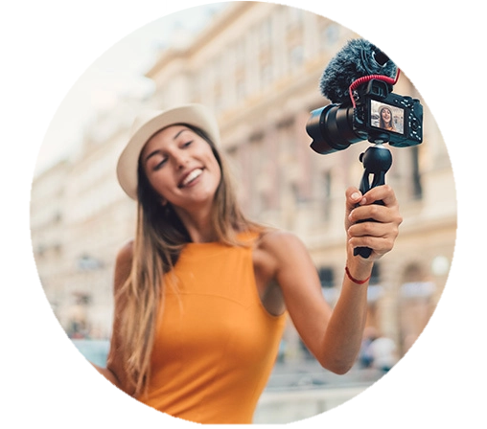
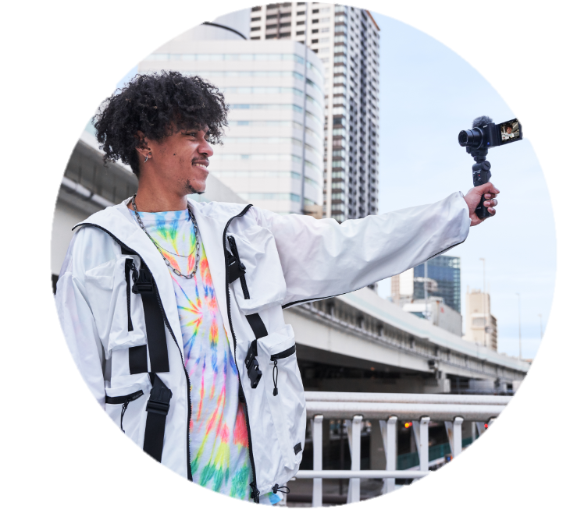


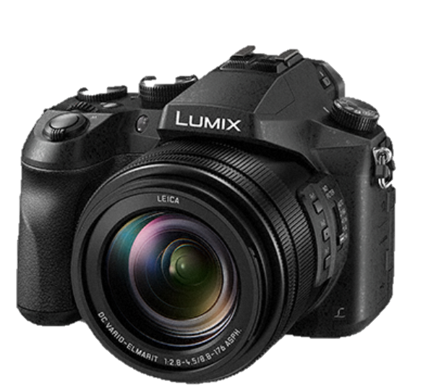
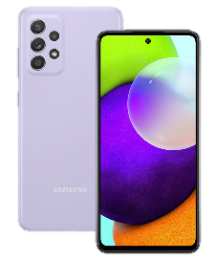
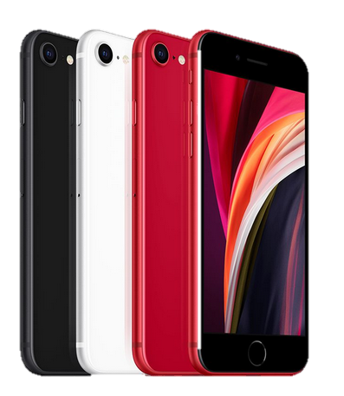
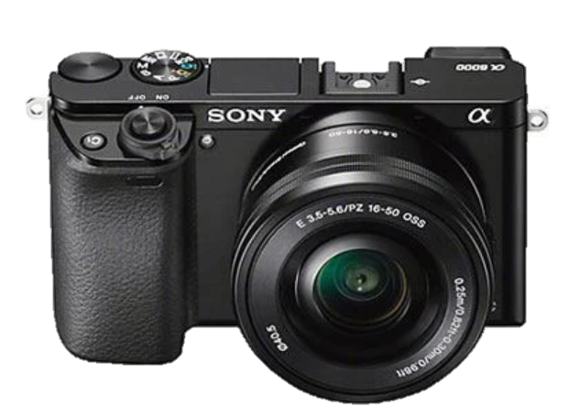
JOBY HandyPod™ 2 : Target
Dual Function mini tripod and hand grip for the Content Creator
JB01871–BWW / JB01872-BWW / JB01873-BWW / JB01874-BWW / JB01875–BWW
Sales Deck
Consumer
Vloggers
Entry Level
Travel Photography
Capturing Memories
Smart Creator
Mobile Phone Driven
Hardware
Compact Mirrorless
Consumer Level
Bridge Cameras
Value Driven
Mobile Phone
All levels

Slide 5
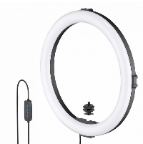
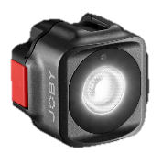





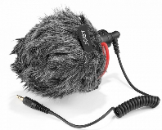
JOBY HandyPod™ 2 Family : Range
Dual Function mini tripod and hand grip for the Content Creator
JB01871–BWW / JB01872-BWW / JB01873-BWW / JB01874-BWW / JB01875–BWW
Sales Deck
Family
Pairs with
Beamo™ Mini
JB01578-BWW
Beamo™ Ring Light 12”
JB01733
HandyPod 2
HandyPod 2 Kit
Wavo™ Mobile
JB01643-BWW
HandyPod 2 Family Pairs with our Content Creation solutions via cold shoe
HandyPod 2 Family

Slide 6
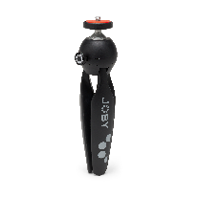
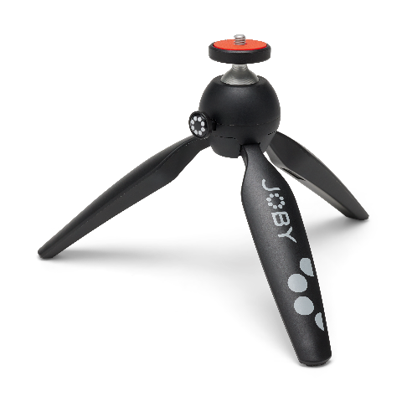
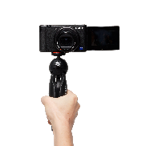
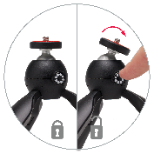
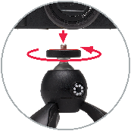
JOBY HandyPod™ 2 : Key Sales Points
Dual Function mini tripod and hand grip for the Content Creator
JB01871–BWW / JB01872-BWW / JB01873-BWW / JB01874-BWW / JB01875–BWW
Sales Deck
Dual Function
Works as a table top tripod or as a handheld support
Simple & Secure
Locking wheel nut
Push Button adjustable ball head
Durable Design
Supports hardware up to 1kg
Lightweight
Lightweight and easy to carry
Upgrade
Works with a variety of JOBY mounts and accessories

Slide 7

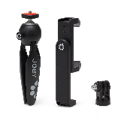
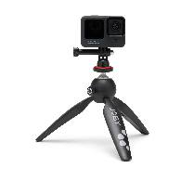
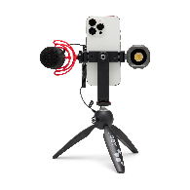
JOBY HandyPod™ 2 Kit : Key Sales Points
Dual Function mini tripod and hand grip for the Content Creator
JB01871–BWW / JB01872-BWW / JB01873-BWW / JB01874-BWW / JB01875–BWW
Sales Deck
Dual Function
Works as a table top tripod or as a handheld support
Simple & Secure
Locking wheel nut
Push Button adjustable ball head
Durable Design
Supports hardware up to 1kg
Smartphone and Action Cam Ready
Supplied with GripTight™ 360 Phone Mount
Supplied with Pin Joint Mount
Vlog Friendly
Add lights and mics to phone mount directly
Rotate easily for vertical storytelling

Slide 8
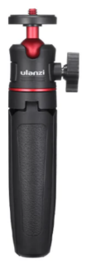
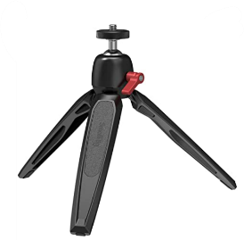
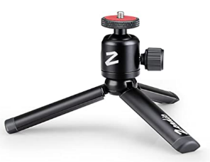
JOBY HandyPod™ 2 Family: Market
Dual Function mini tripod and hand grip for the Content Creator
JB01871–BWW / JB01872-BWW / JB01873-BWW / JB01874-BWW / JB01875–BWW
Sales Deck
Competitors
HandyPod 2 vs. Marketplace
Lots of cheap quality competition
Premium Materials, function and finish – Durable Aluminum and Technopolymer finish
Part of JOBY ecosystem
Unique Ballhead built in (with locking wheel screw)
GripTight 360 phone mount is a game changer

