Slide 1
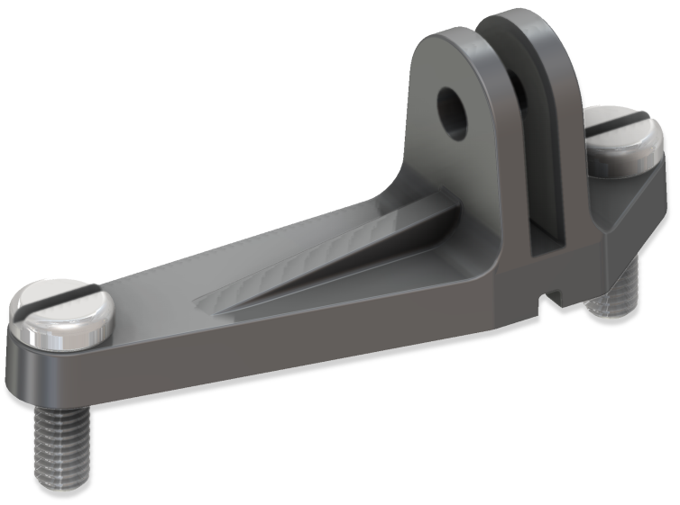
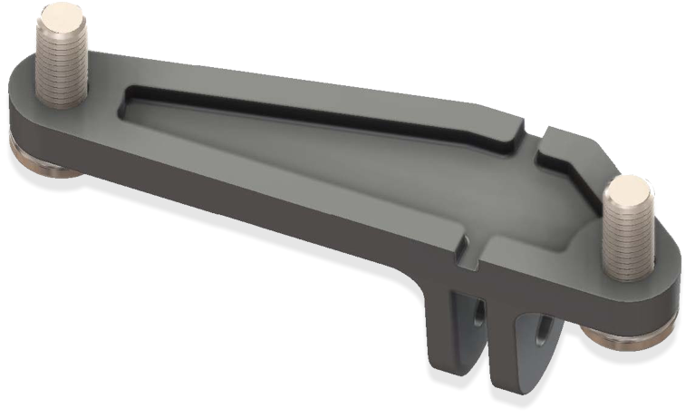
JOBY SeaPal GoMount
GoPro feet-Compatible Mount for SeaPal Waterproof Case
JB01951-BWW
Sell Sheet
The GoMount for SeaPal allows for the SeaPal Waterproof Case to be mounted to any existing mounts, grips or devices originally designed for use with GoPro cameras. The GoMount comes with all mounting hardware to secure to your SeaPal Waterproof Case.
JOBY has partnered with AquaTech, who has been making water housings for the world’s best ocean photographers for over 20 years. We took all of that knowledge and experience and created SeaPal. Whether you're surfing, snorkeling, fishing, freediving, kayaking or just taking photos of the kids in the backyard pool, the SeaPal protects your phone and lets you focus on getting the perfect shot.
Materials Glass Filled Polycarbonate
Dimensions: 2.5x0.2x7cm(1x0.1.5x2.7in)
Net Weight: 10g (0.02 lbs)
Manufacture Warranty One Year Warranty
Easy
to Install
GoPro feet
Allows SeaPal Case to connect to GoPro-compatible tripods
Perfect fit
to SeaPal Waterproof Case
Ready to go
Comes with all mounting hardware
Tripod-Compatible
Works with JOBY TelePod Sport and Action Tripod

